Slide 1

x2VOL.com
Student Registration and Training Guide

Slide 2

First time login: www.x2VOL.com

Slide 3
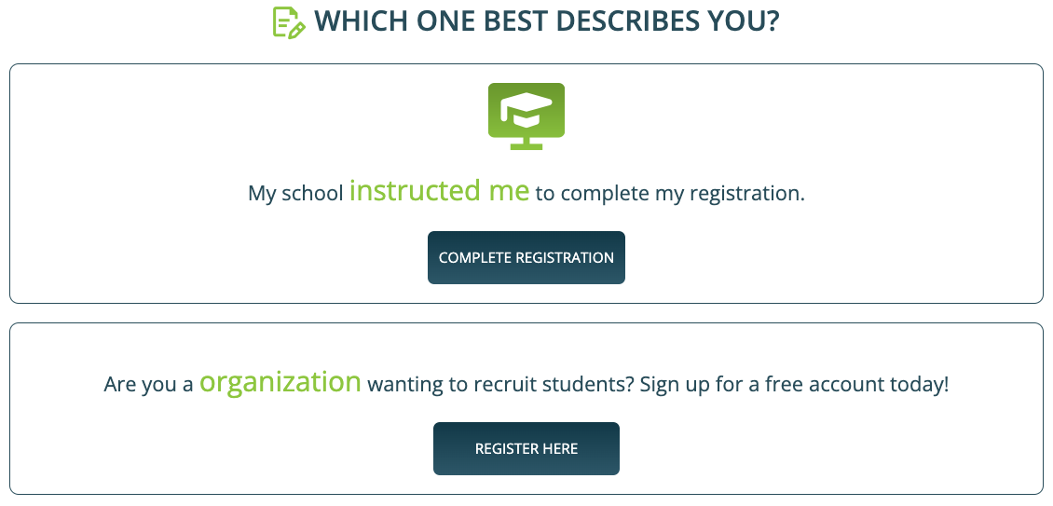
Complete Registration

Slide 4
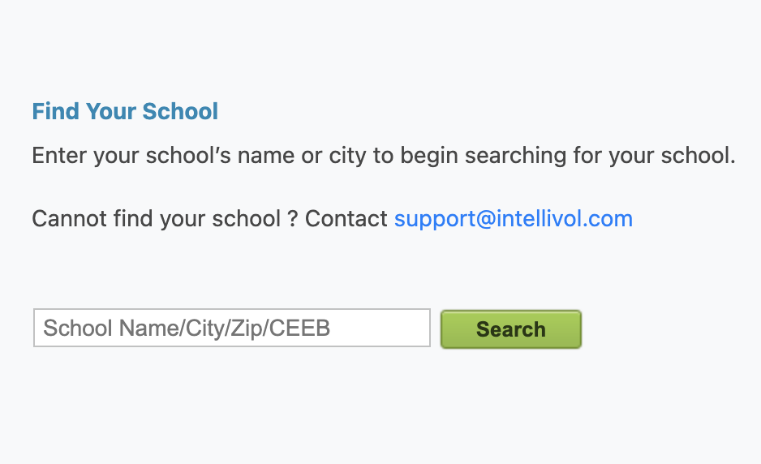
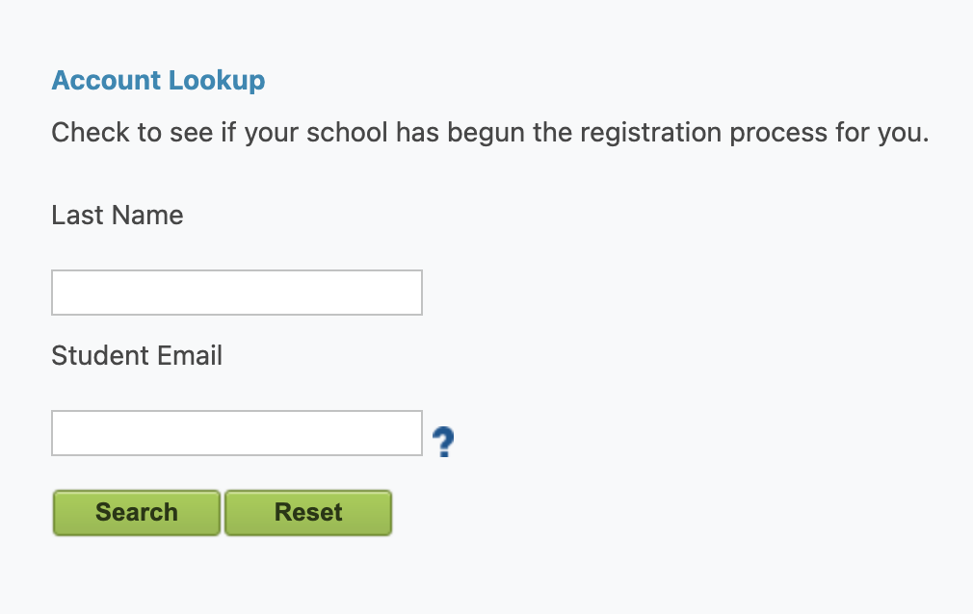
Find your School and Complete Account Lookup
Enter your school's name, city or zip code and click “Search”
Select your school from dropdown
Enter your Last name and Student ID or Email* and click “Search”
*The site will prompt you on which to enter.

Slide 5
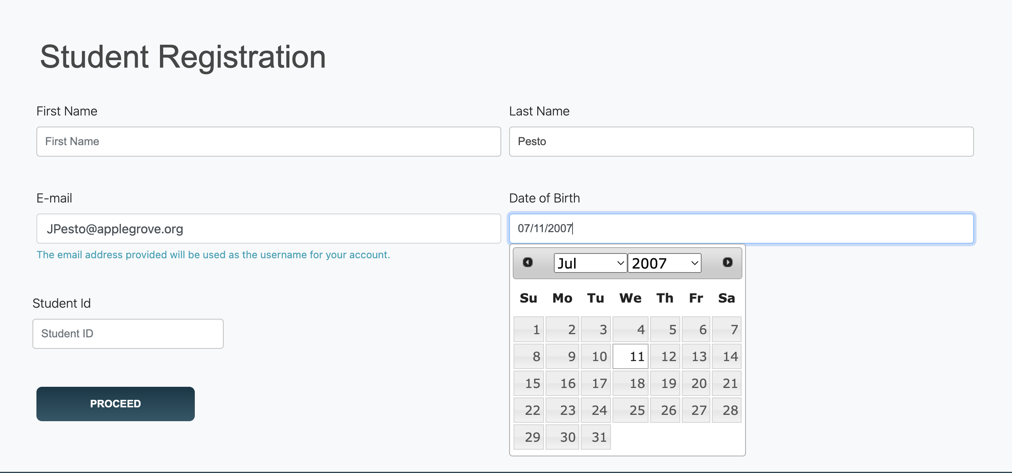
Complete Your Profile
Set a password here. It can be used with the mobile app too.

Slide 6
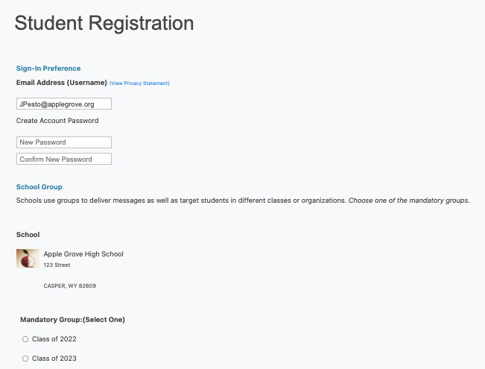
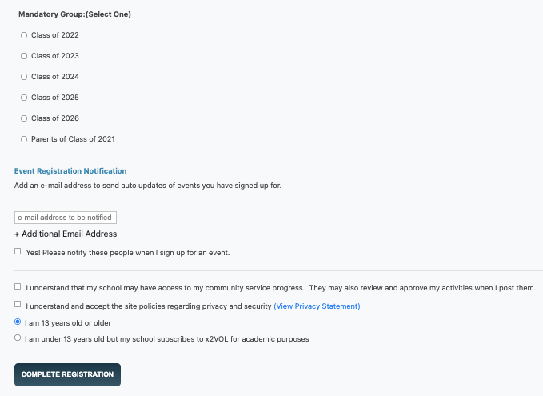
Create a Password for your Account*
Select/Confirm your Group and Complete Registration
*Password will work for the mobile app.

Slide 7
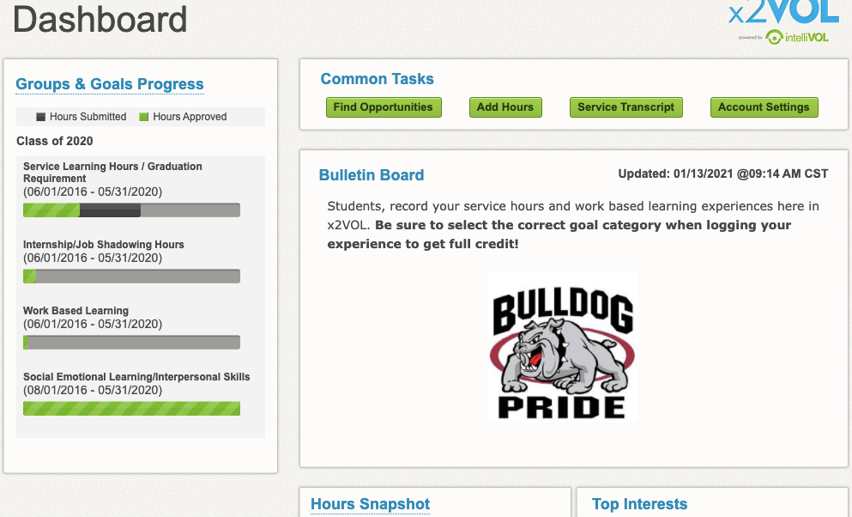
View your Dashboard

Slide 8
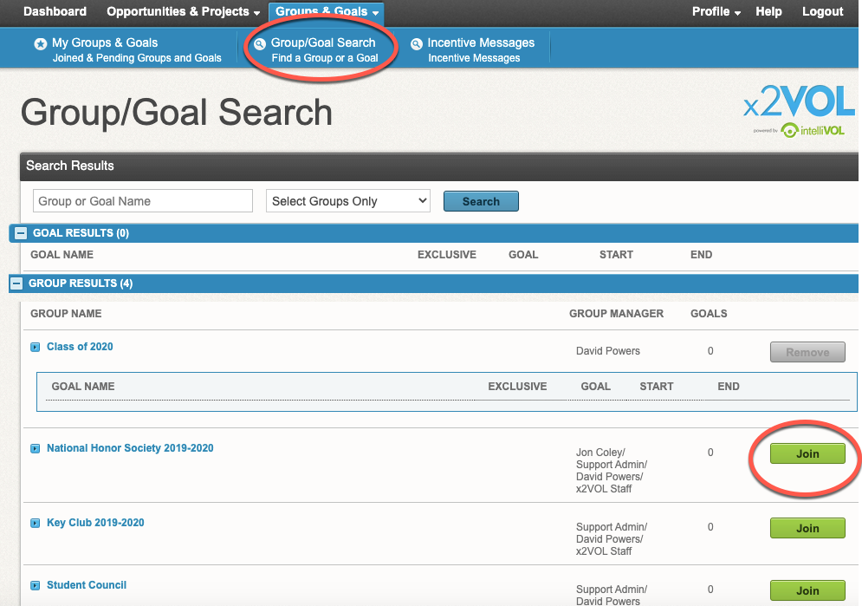
Join Groups and Goals

Slide 9
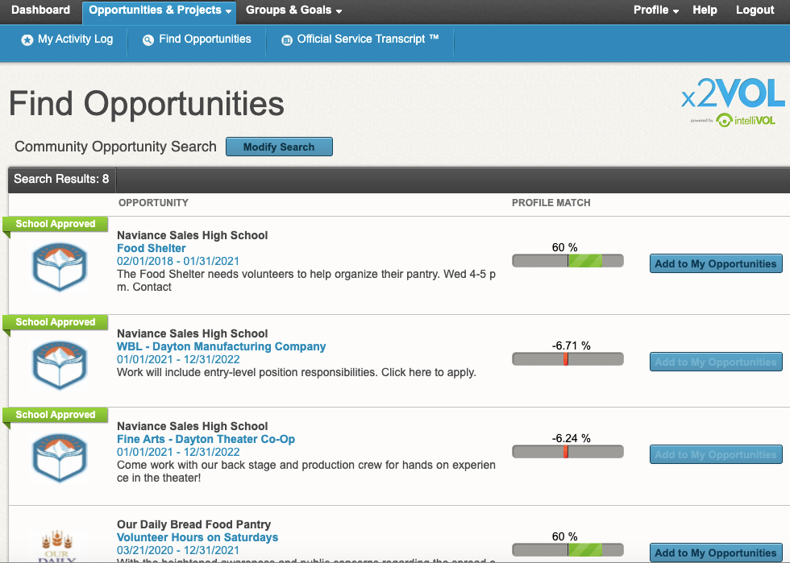
Find Opportunities and Sign Up

Slide 10
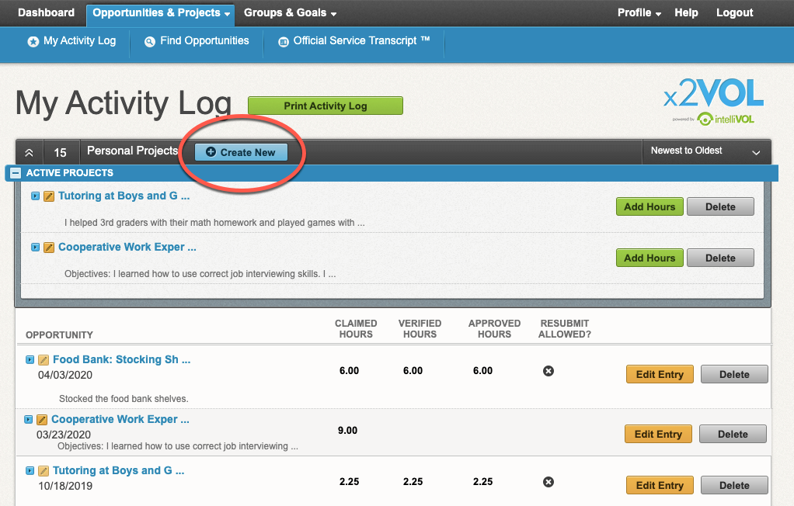
Log Hours and Experiences
Add a new personal project
Or add hours to a saved recurring project
Or add hours to an opportunity you already signed up for at the bottom

Slide 11
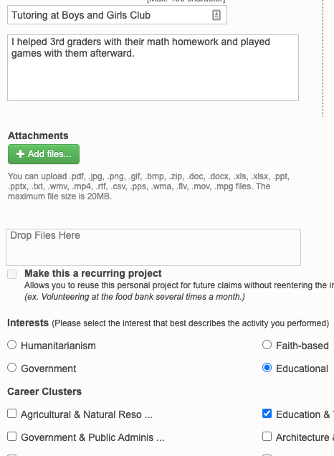
Log the details
Title your activity and add a description
Add attachments
Make it a recurring project to use later on
Apply Interests and Career Clusters

Slide 12
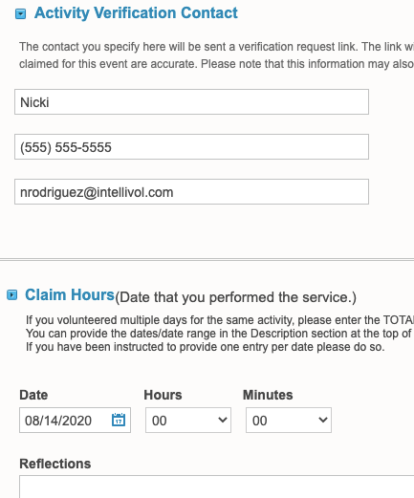
Log the details
Enter the Verification Contact Information accurately!
Enter the date and time you spent doing this activity
Add reflections

Slide 13
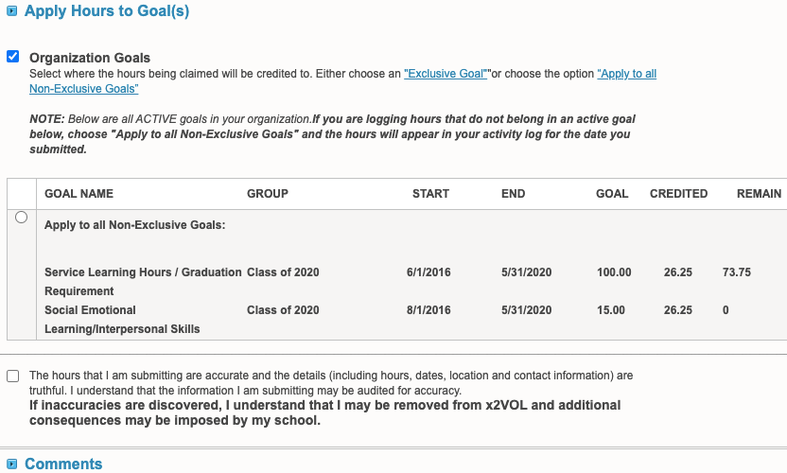
Log the details
Select the goal or category this activity belongs to
Check the honor statement

Slide 14
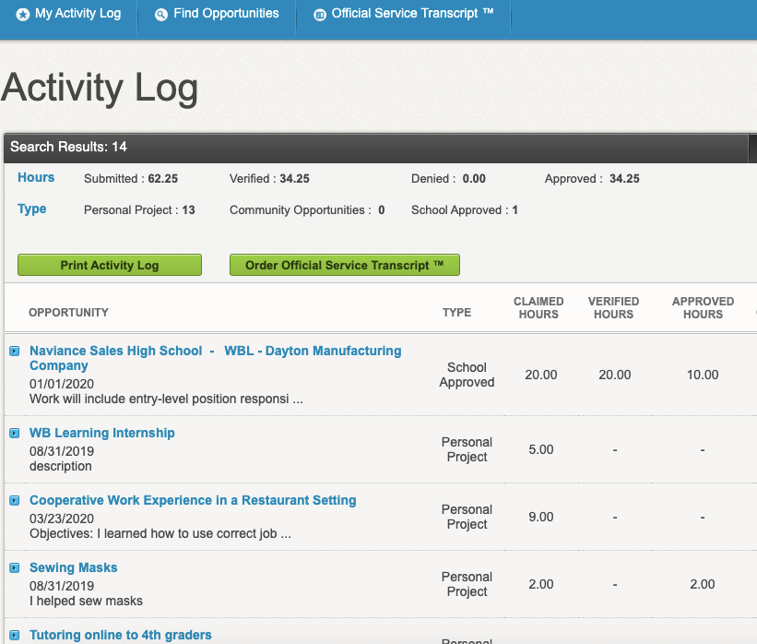
Print your Activity Log & Order an Official Service Transcript™

Slide 15

Download the x2VOL mobile app!
Try our iOS and Android mobile app to log your hours! Currently available for students, it can be found in the Apple App Store or Google Play Store.

Slide 16
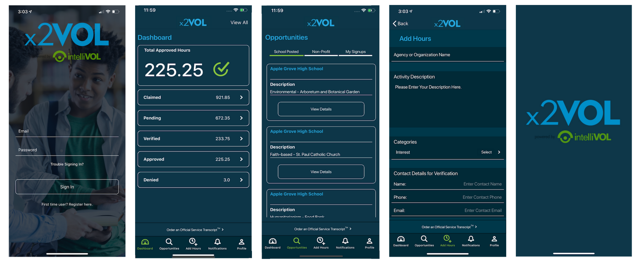
iOS Screens

Slide 17



Need Help?
Contact us:
Support@intellivol.com
866.906.6400
x2VOL.com

