Slide 1


x2VOL.com
Student Registration and Training Guide

Slide 2



First time login: www.x2VOL.com

Slide 3
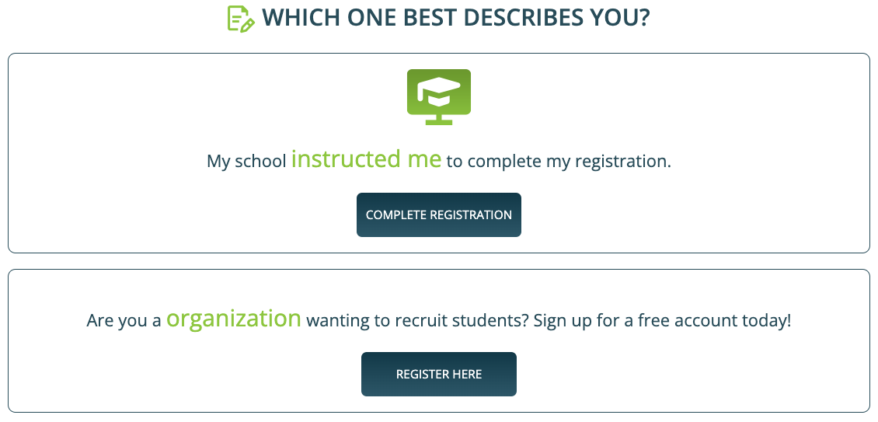
Complete Registration

Slide 4
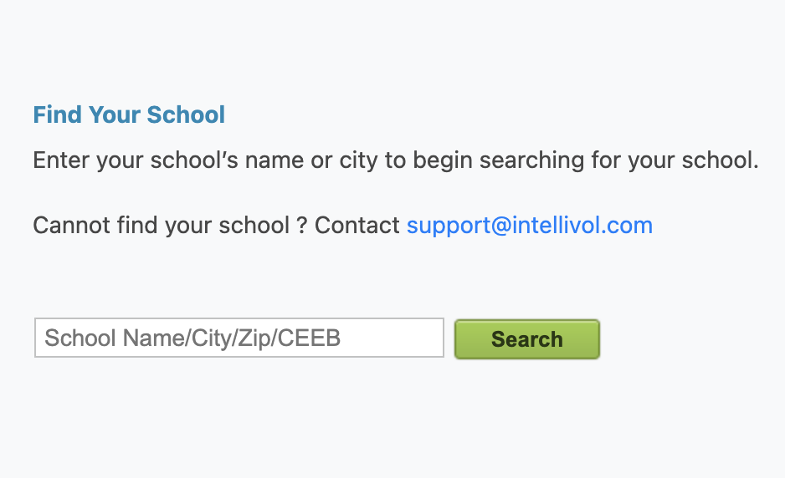
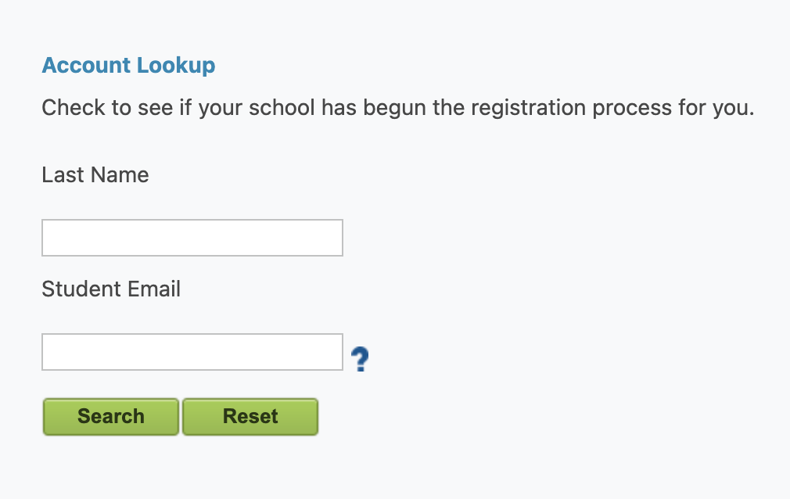
Find your School and Complete Account Lookup
Enter your school's name, city or zip code and click “Search”
Select your school from dropdown
Enter your Last name and Student ID or Email* and click “Search”
*The site will prompt you on which to enter.

Slide 5
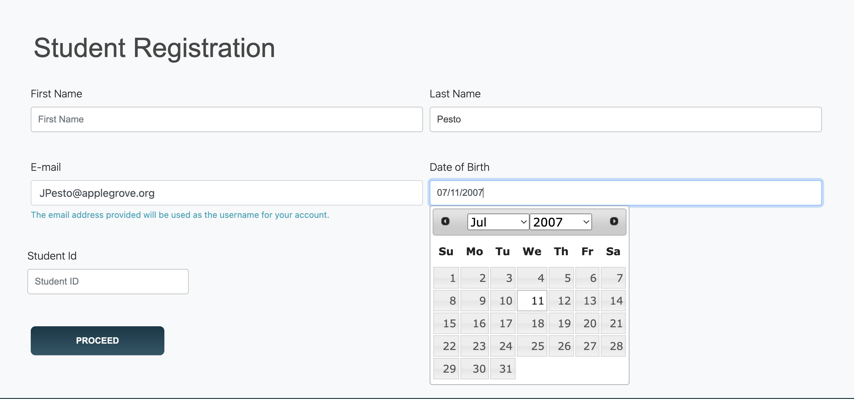
Complete Your Profile
Set a password here. It can be used with the mobile app too.

Slide 6
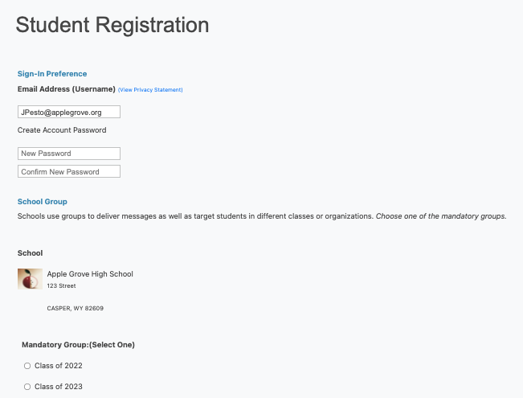
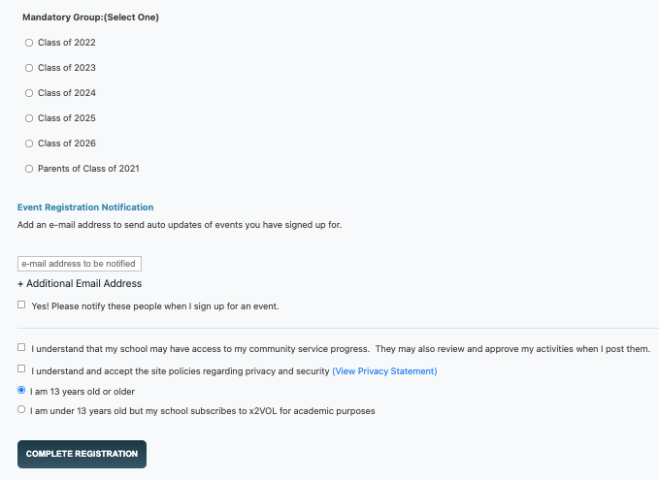
Create a Password for your Account*
Select/Confirm your Group and Complete Registration
*Password will work for the mobile app.

Slide 7
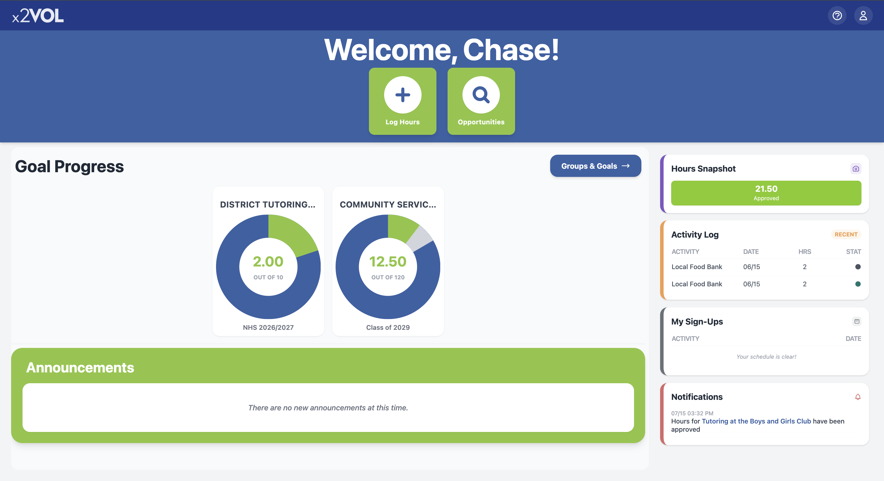
View your Dashboard

Slide 8
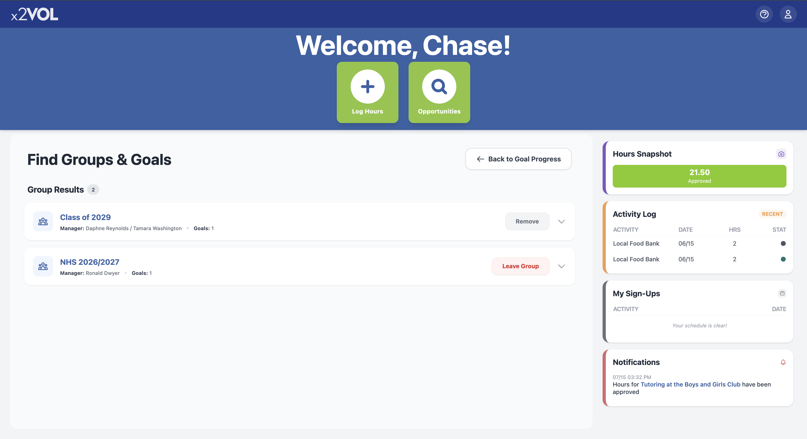
Join Groups and Goals
Click “Groups & Goals” near the top of your Dashboard
On the next screen, you can manage your Groups & Goals

Slide 9
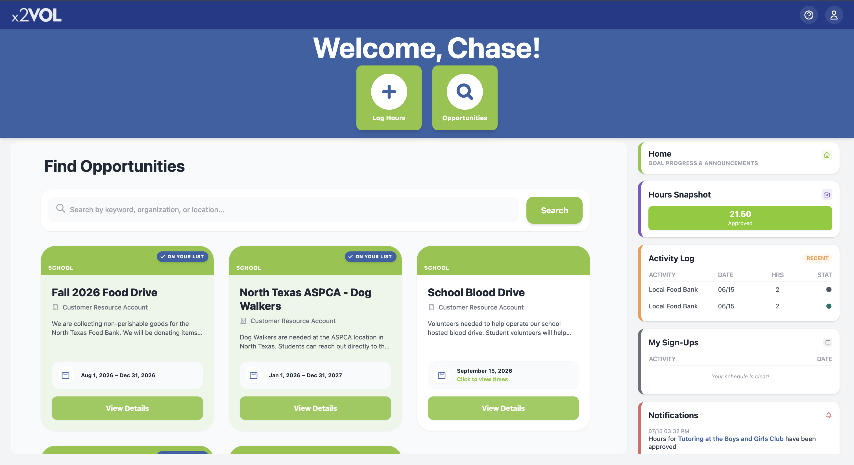
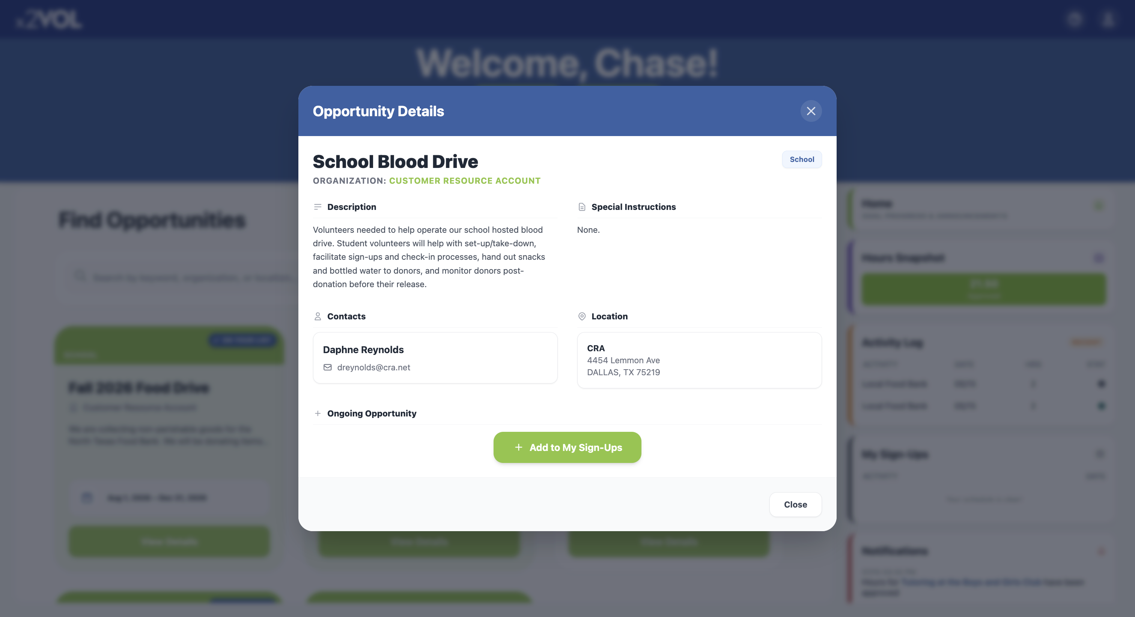
Find Opportunities and Sign Up
Click “Opportunities” Button at the top of your Dashboard
In the list, find an Opportunity & click “View Details”
To sign up for an opportunity, click the “+ Add to My Sign-Ups” button

Slide 10
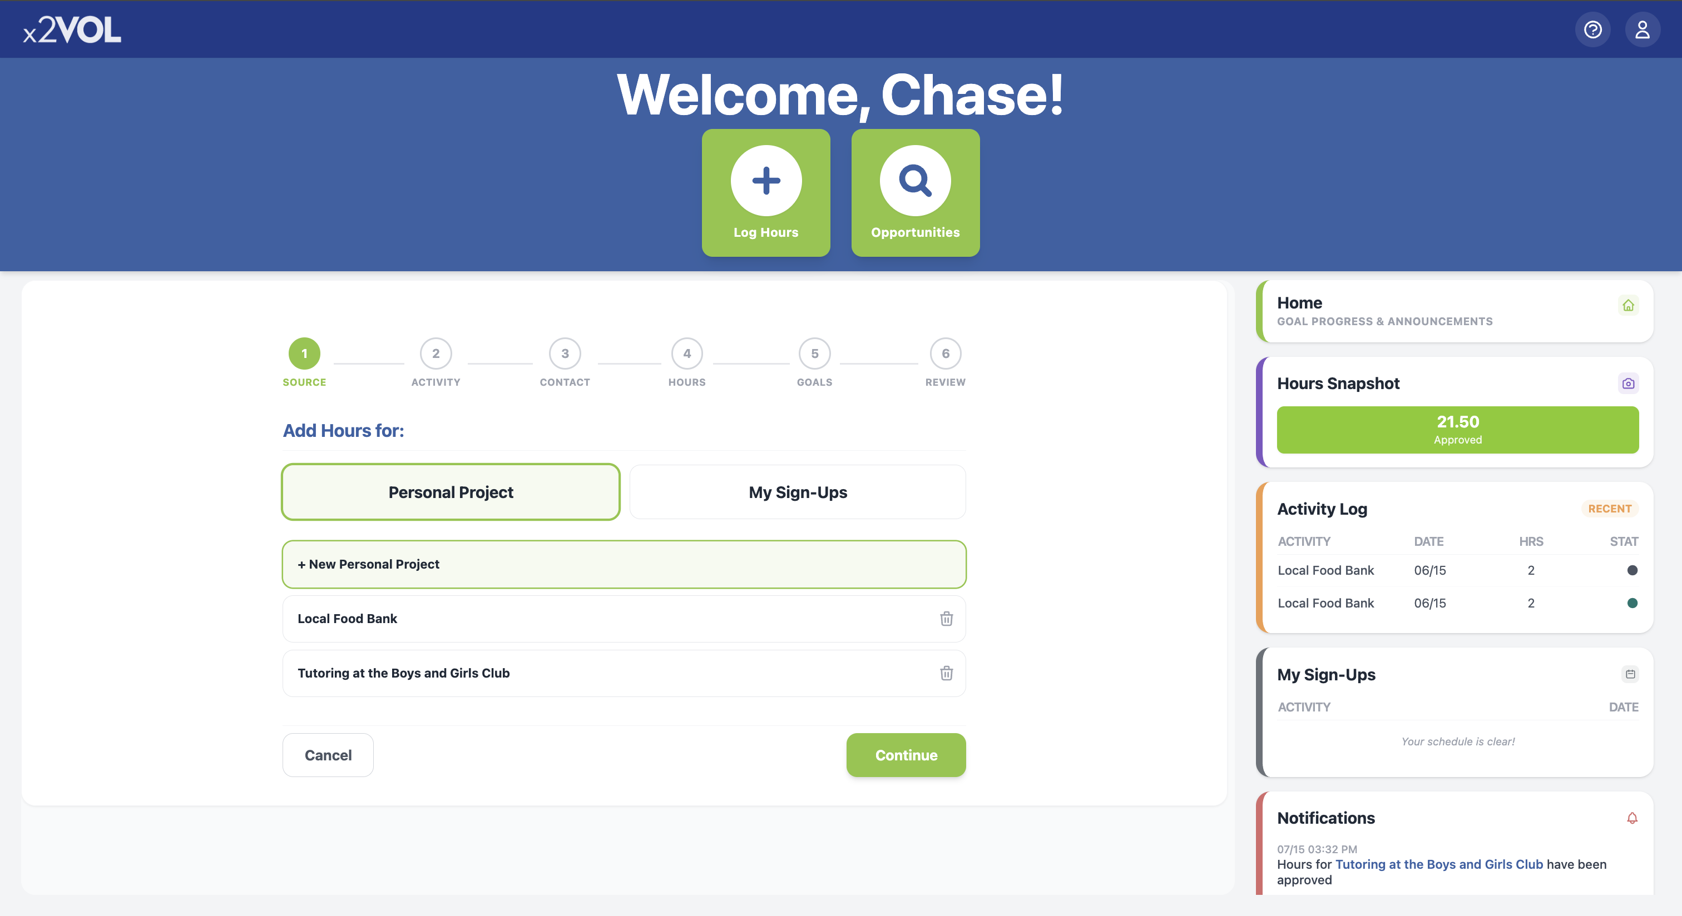
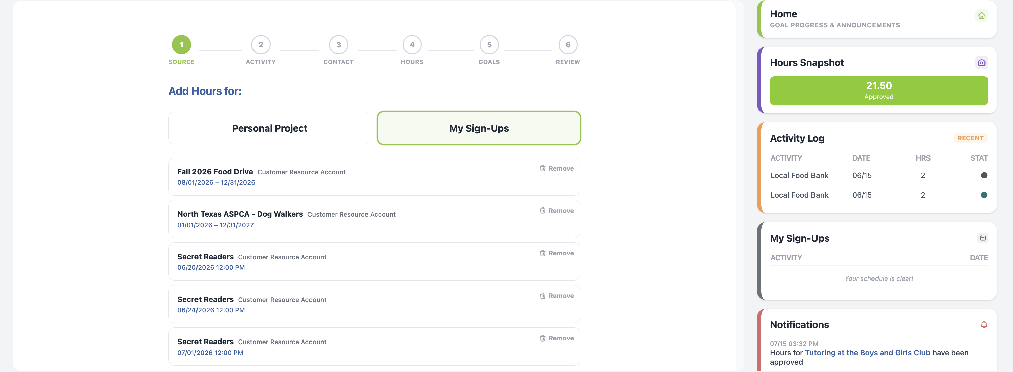
Log Hours and Experiences
Click the “Log Hours” Button
Add a new personal project.
Or add hours to a saved recurring project
Or add hours to an opportunity you already signed up for in “My Sign-Ups”

Slide 11
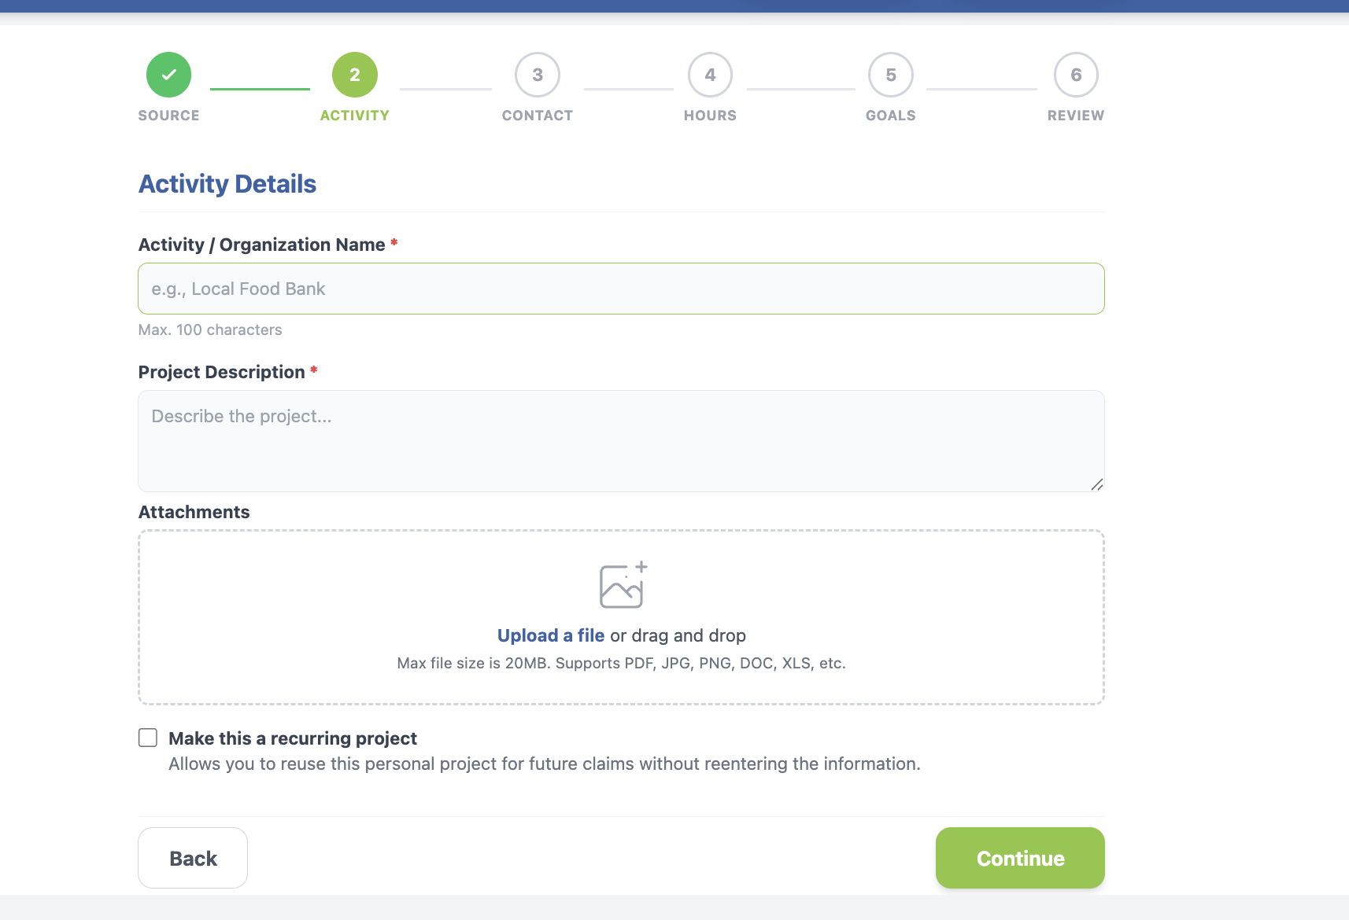
Log the details
Title your activity and add a description
Add attachments
Make it a recurring project to use later

Slide 12
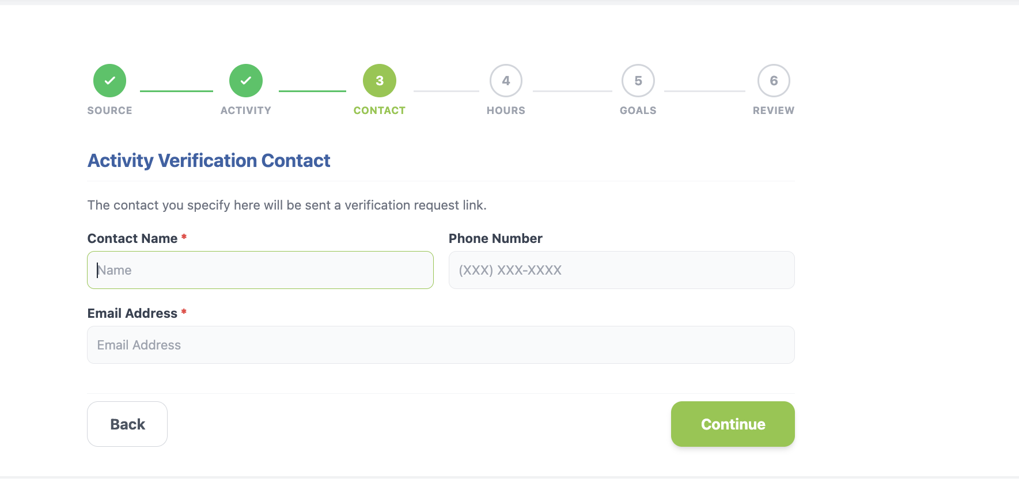
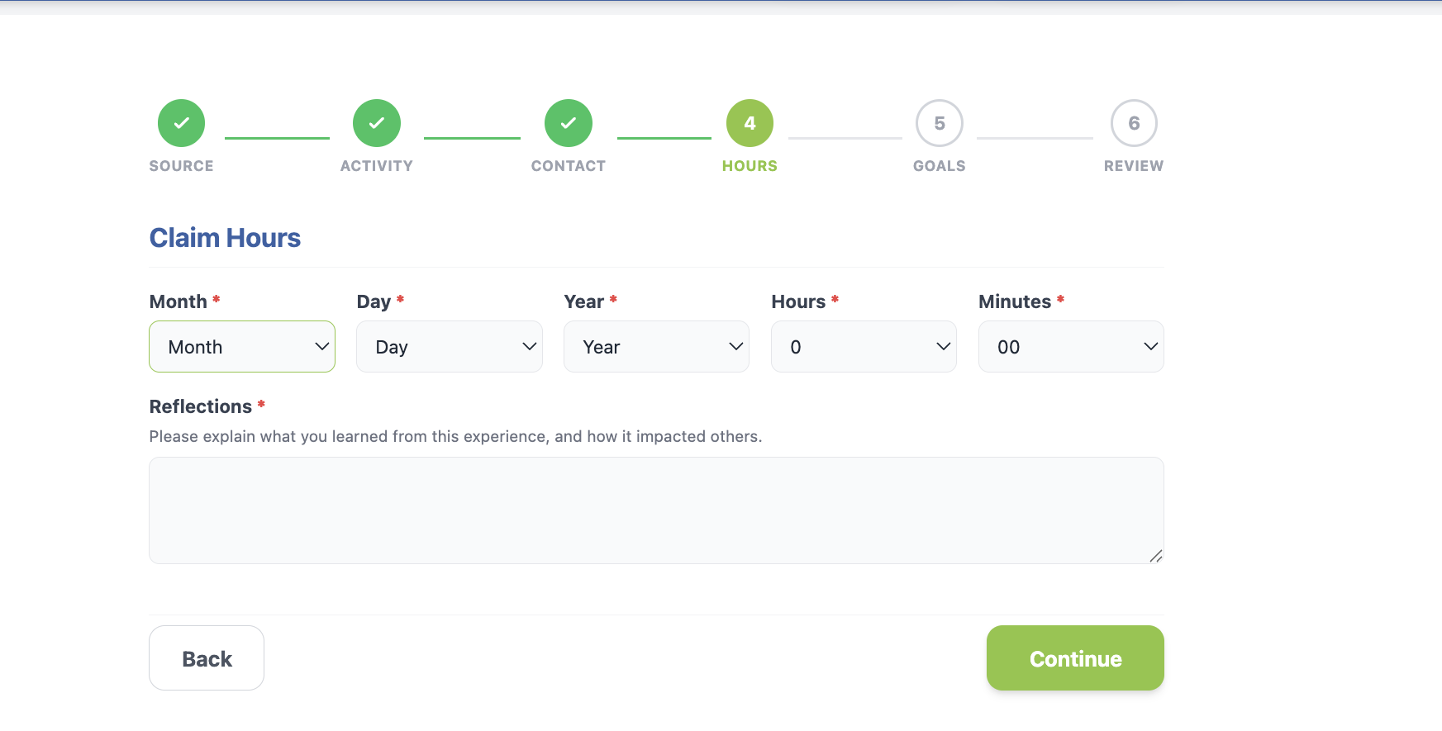
Log the details
Enter the Verification Contact Information accurately!
Enter the date and time you spent doing this activity
Add reflections

Slide 13
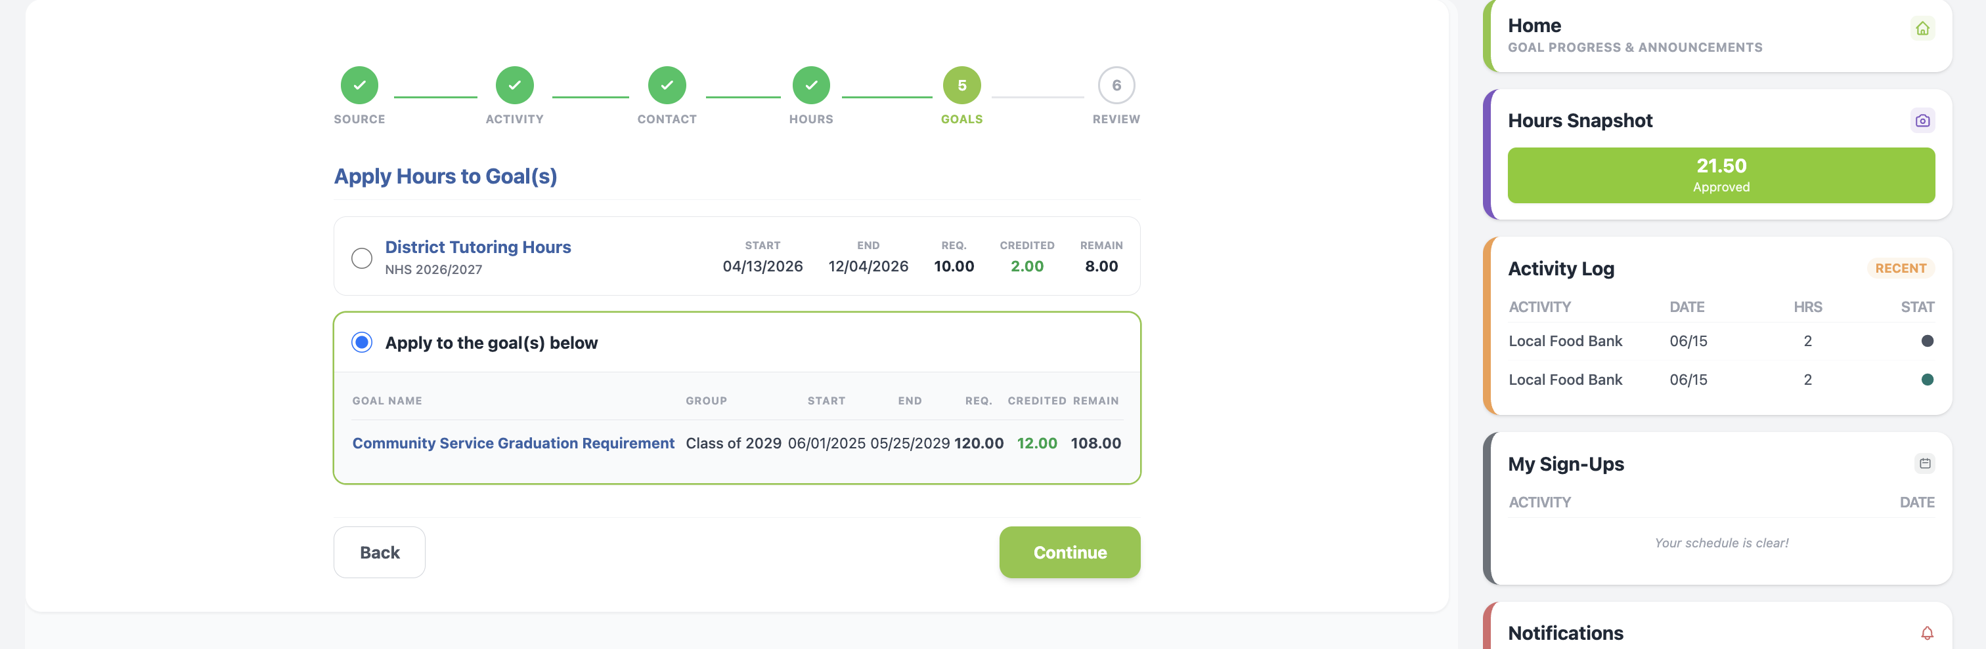
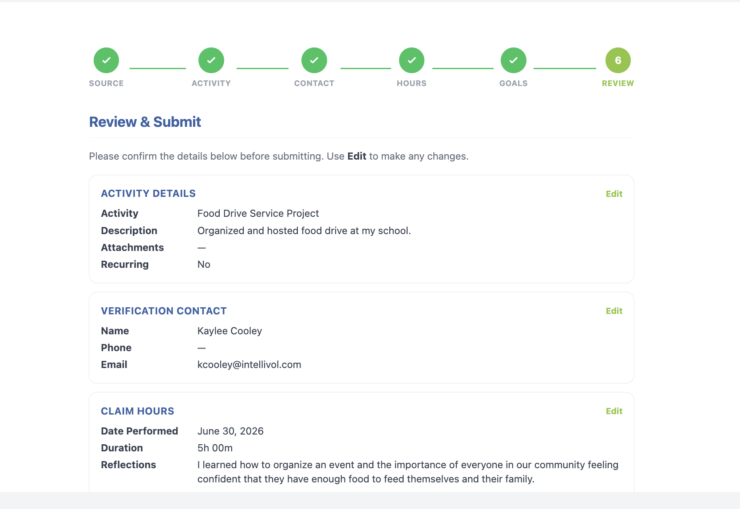
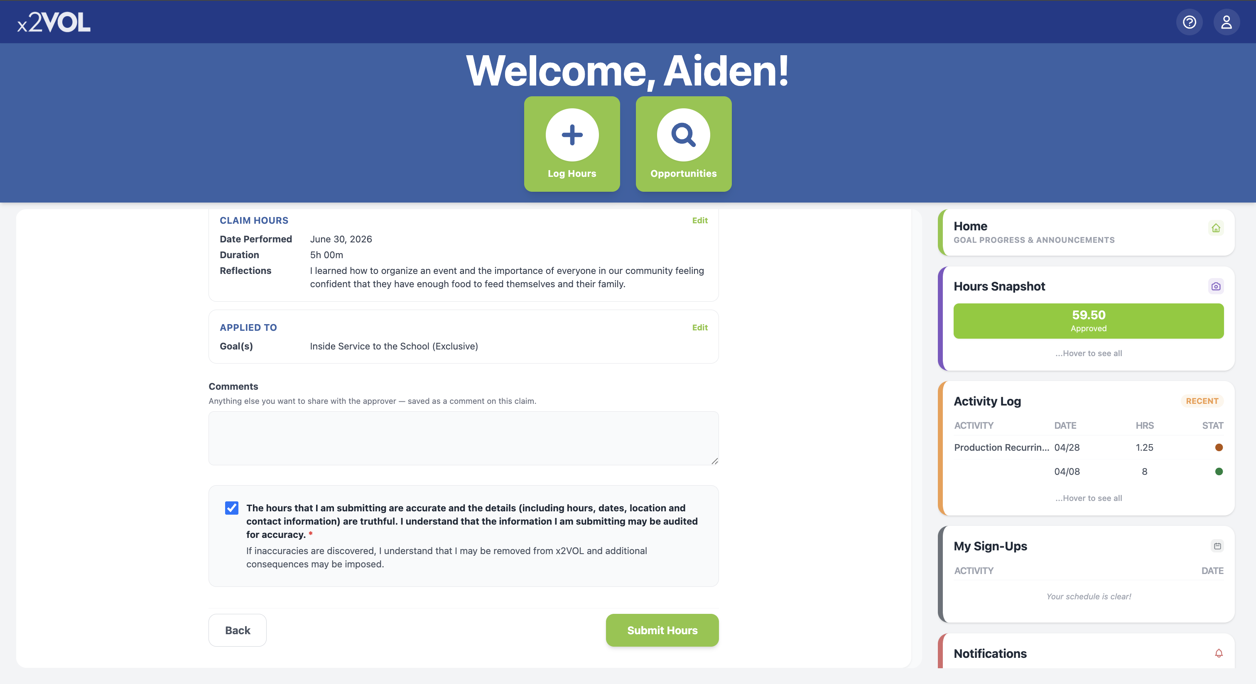
Log the details
Select the goal or category this activity belongs to
Review your submission and check the honor statement

Slide 14
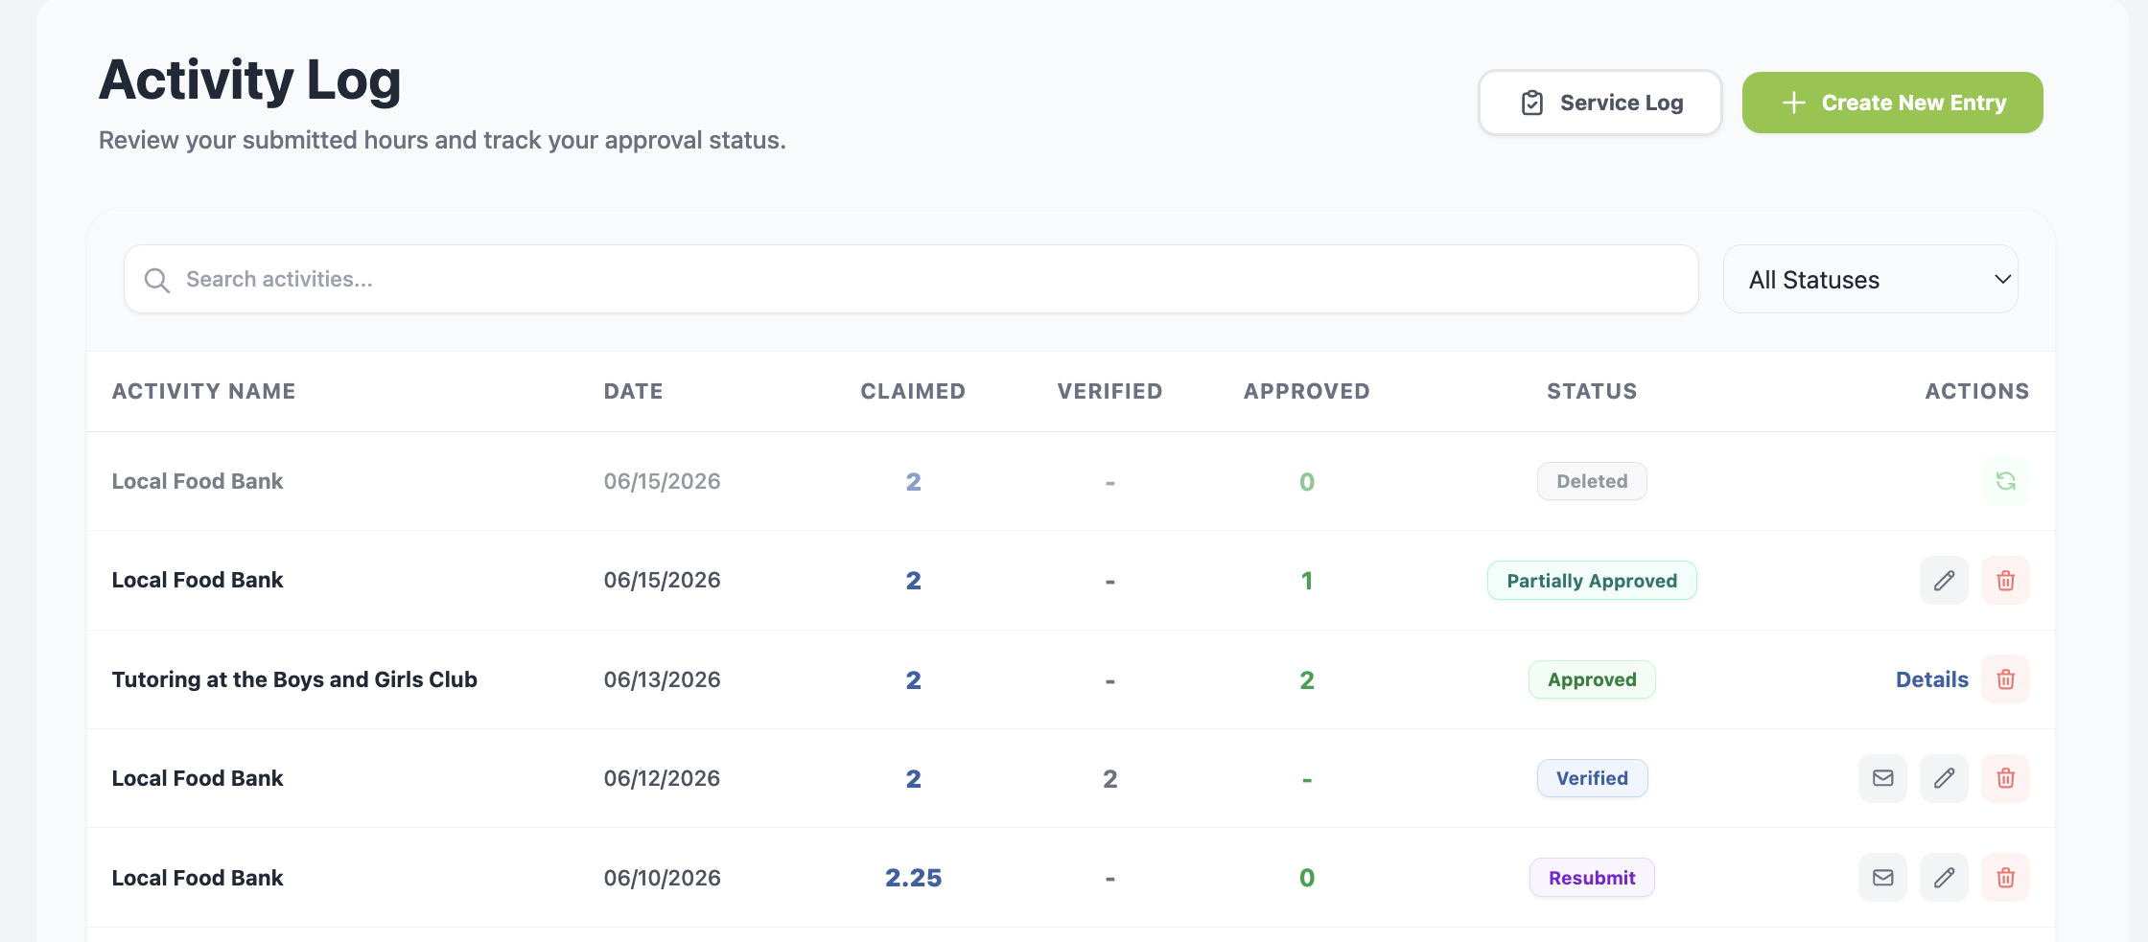
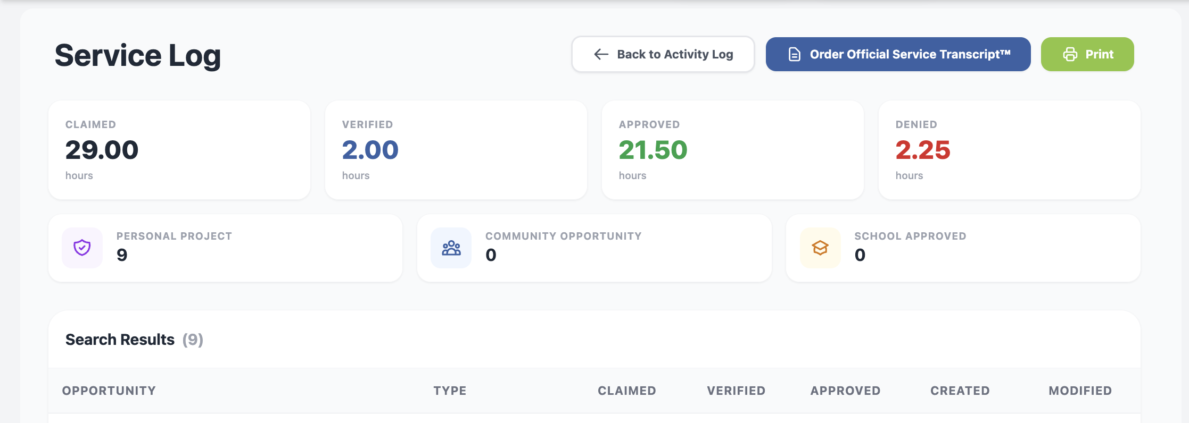
Print your Activity Log & Order an Official Service Transcript™
Click “Activity Log” in the right-side navigation panel
2.
Click “Service Log”
Click “Order Official Service Transcript™” or “Print”

Slide 15



Download the x2VOL mobile app!
Try our iOS and Android mobile app to log your hours! Currently available for students, it can be found in the Apple App Store or Google Play Store.

Slide 16
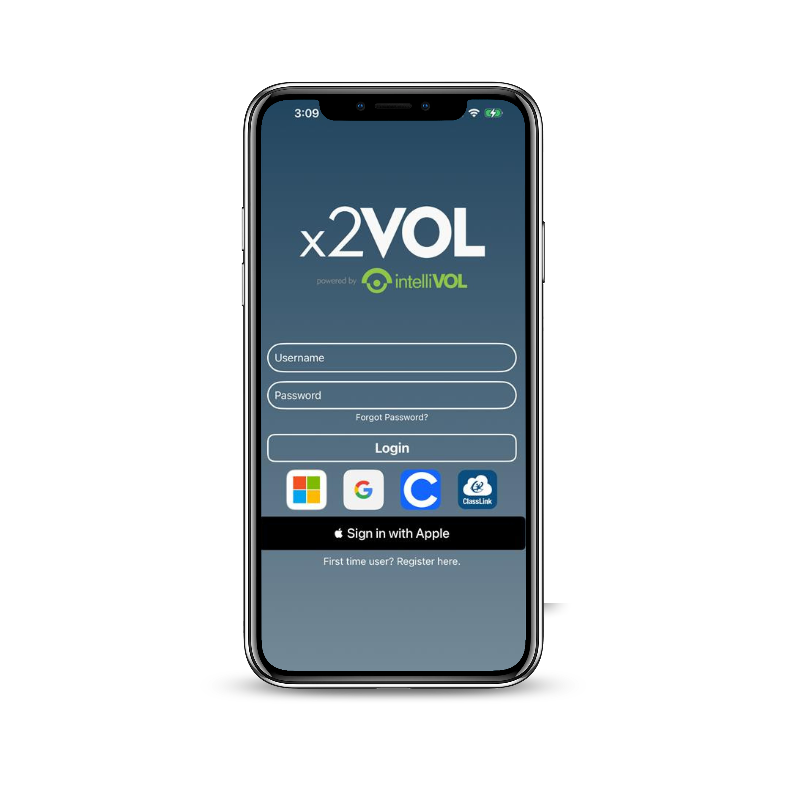
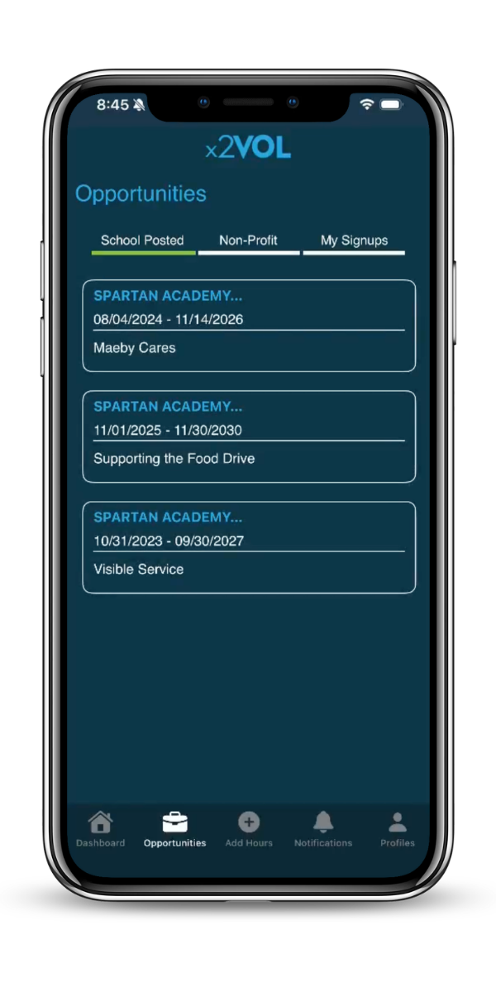
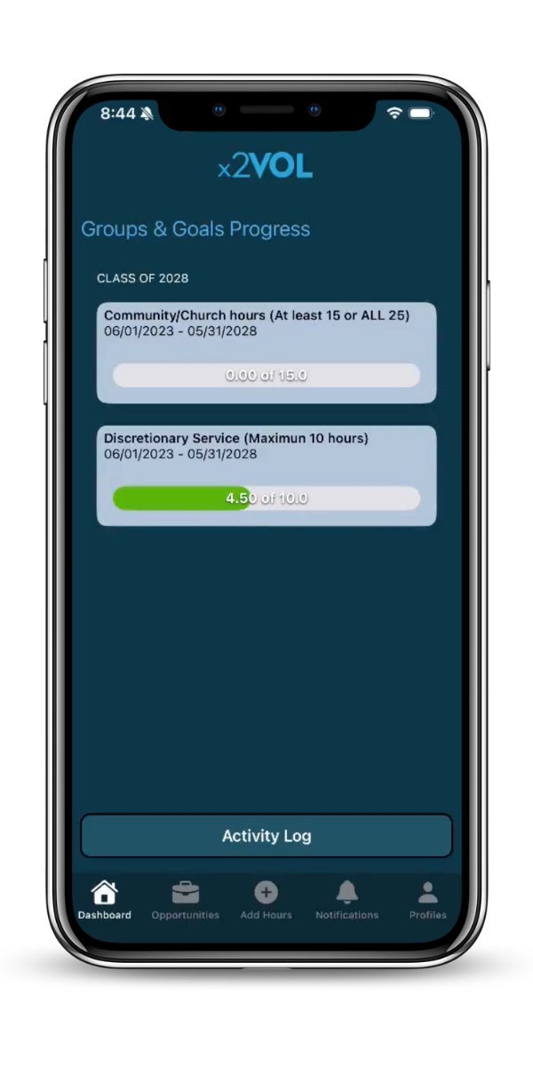
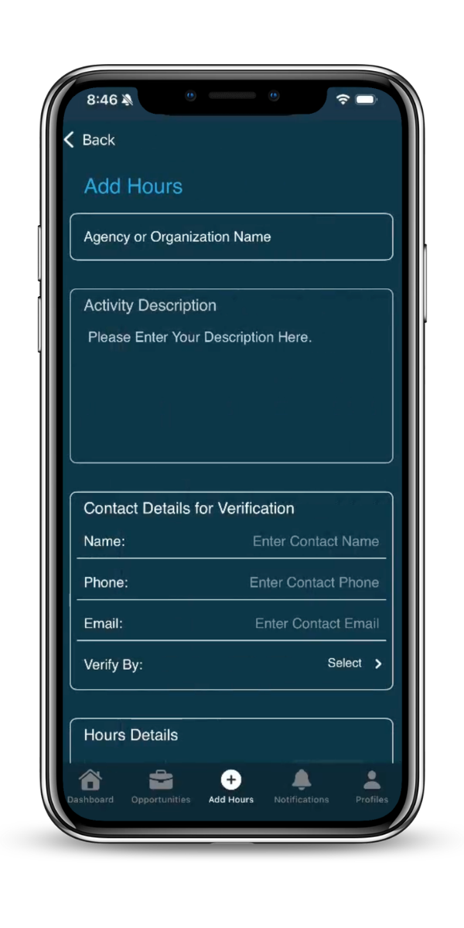
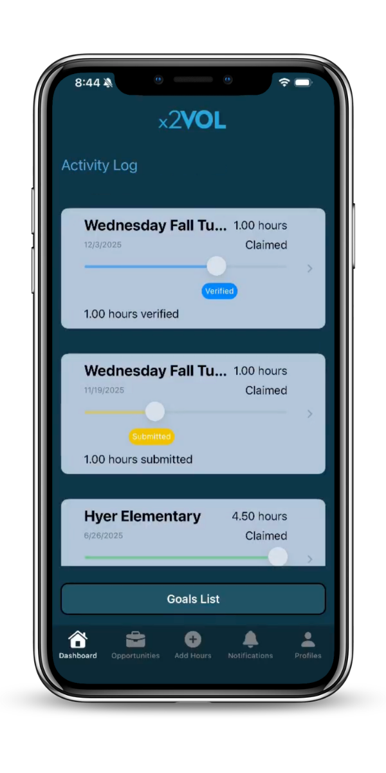






iOS Screens

Slide 17



Need Help?
Contact us:
Support@intellivol.com
866.906.6400
x2VOL.com

