Slide 1


x2VOL.com
Student Registration and Training Guide

Slide 2



Go to www.x2VOL.com and click “LOG IN”

Slide 3
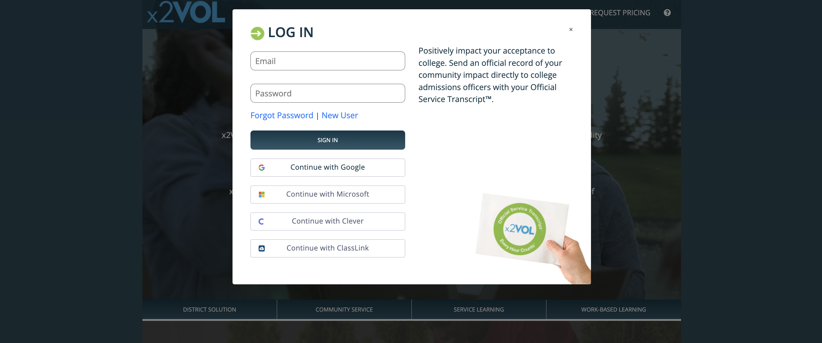
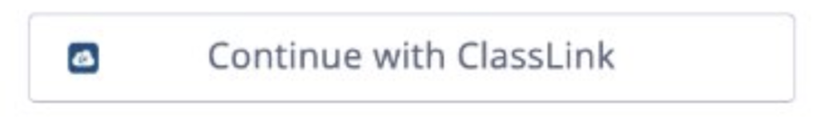
Select your school’s single sign-on option to Log In

Slide 4
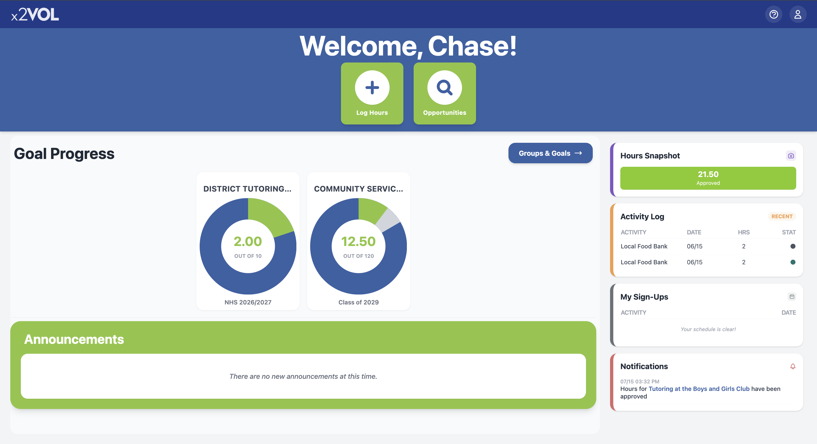
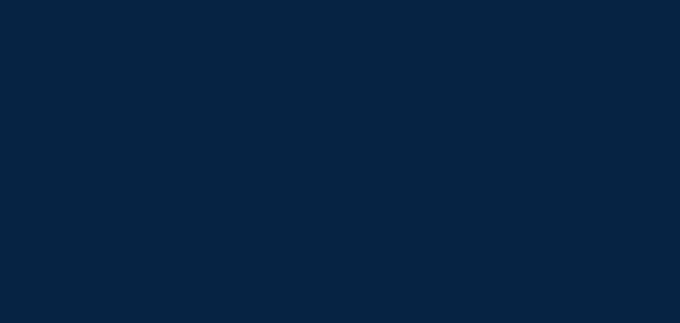

View your Dashboard

Slide 5
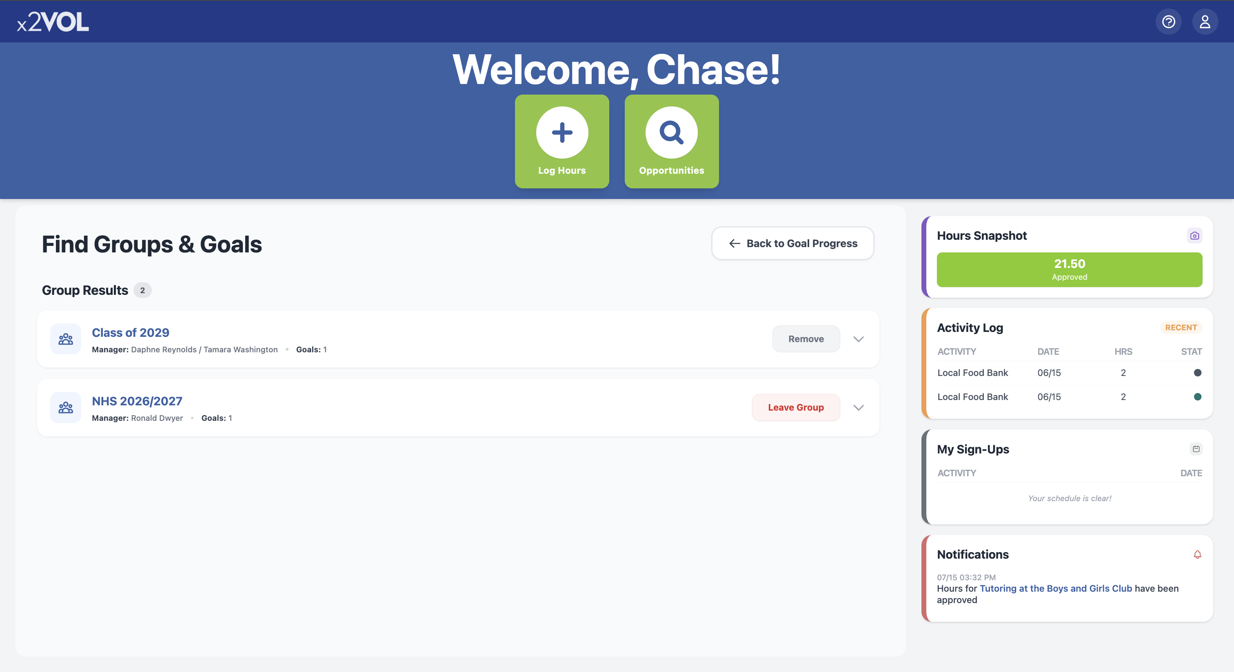
Join Groups and Goals
Click “Groups & Goals” near the top of your Dashboard
On the next screen, you can manage your Groups & Goals

Slide 6
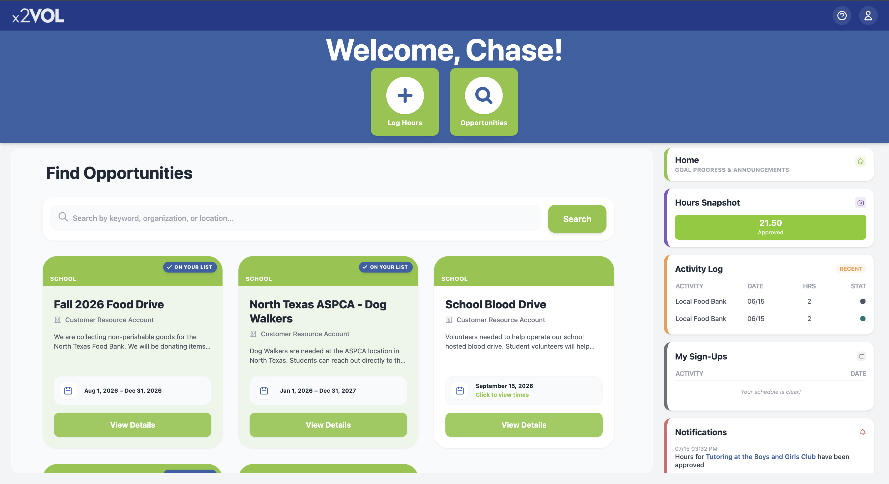
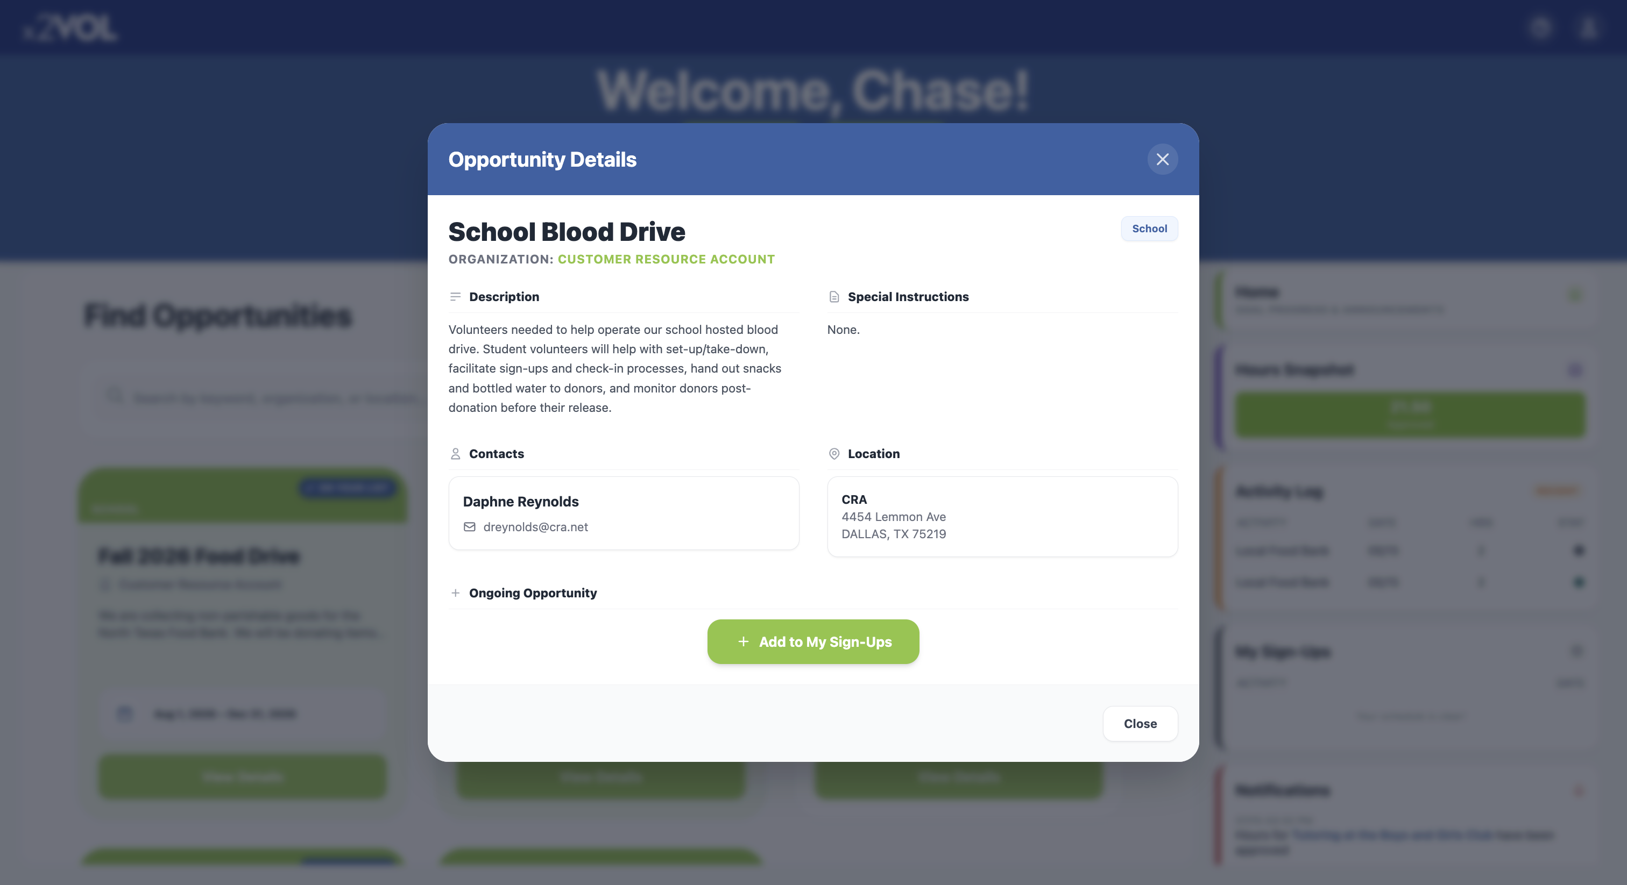
Find Opportunities and Sign Up
Click “Opportunities” Button at the top of your Dashboard
In the list, find an Opportunity & click “View Details”
To sign up for an opportunity, click the “+ Add to My Sign-Ups” button

Slide 7
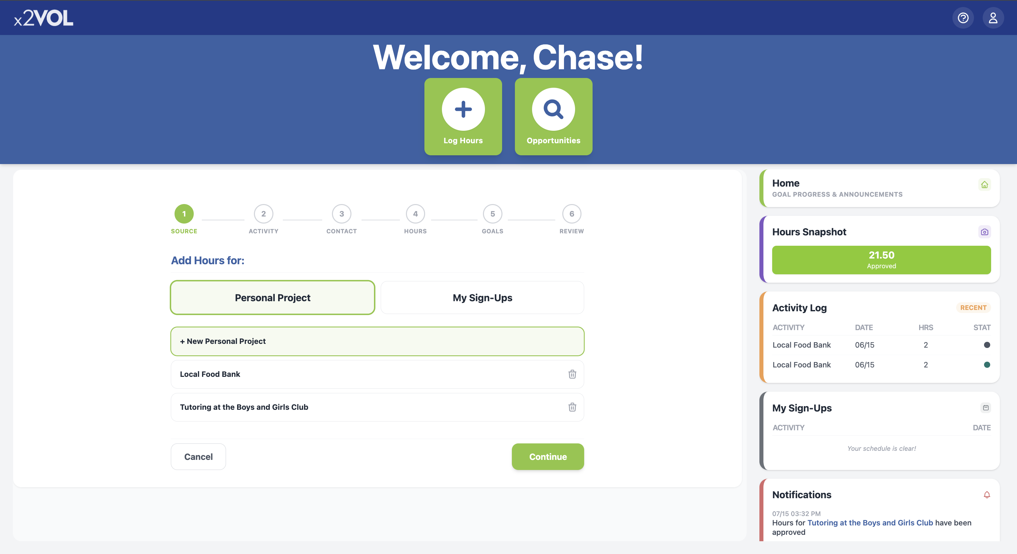
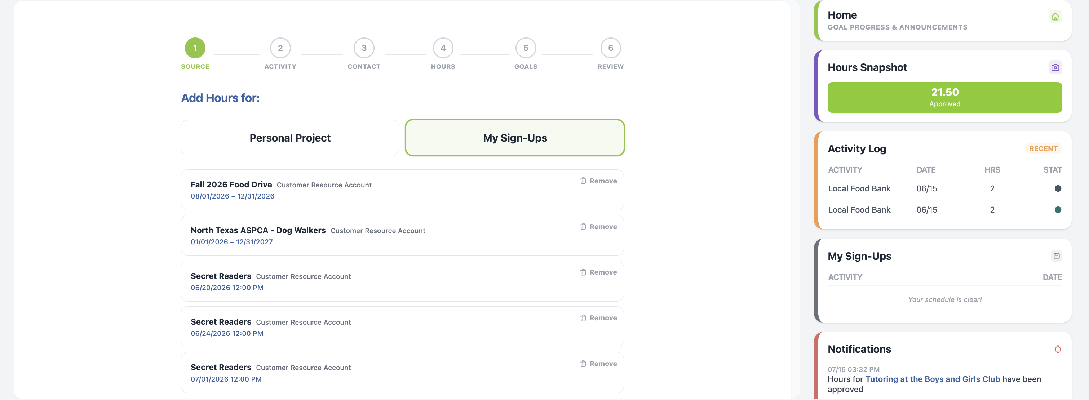
Log Hours and Experiences
Click the “Log Hours” Button
Add a new personal project.
Or add hours to a saved recurring project
Or add hours to an opportunity you already signed up for in “My Sign-Ups”

Slide 8
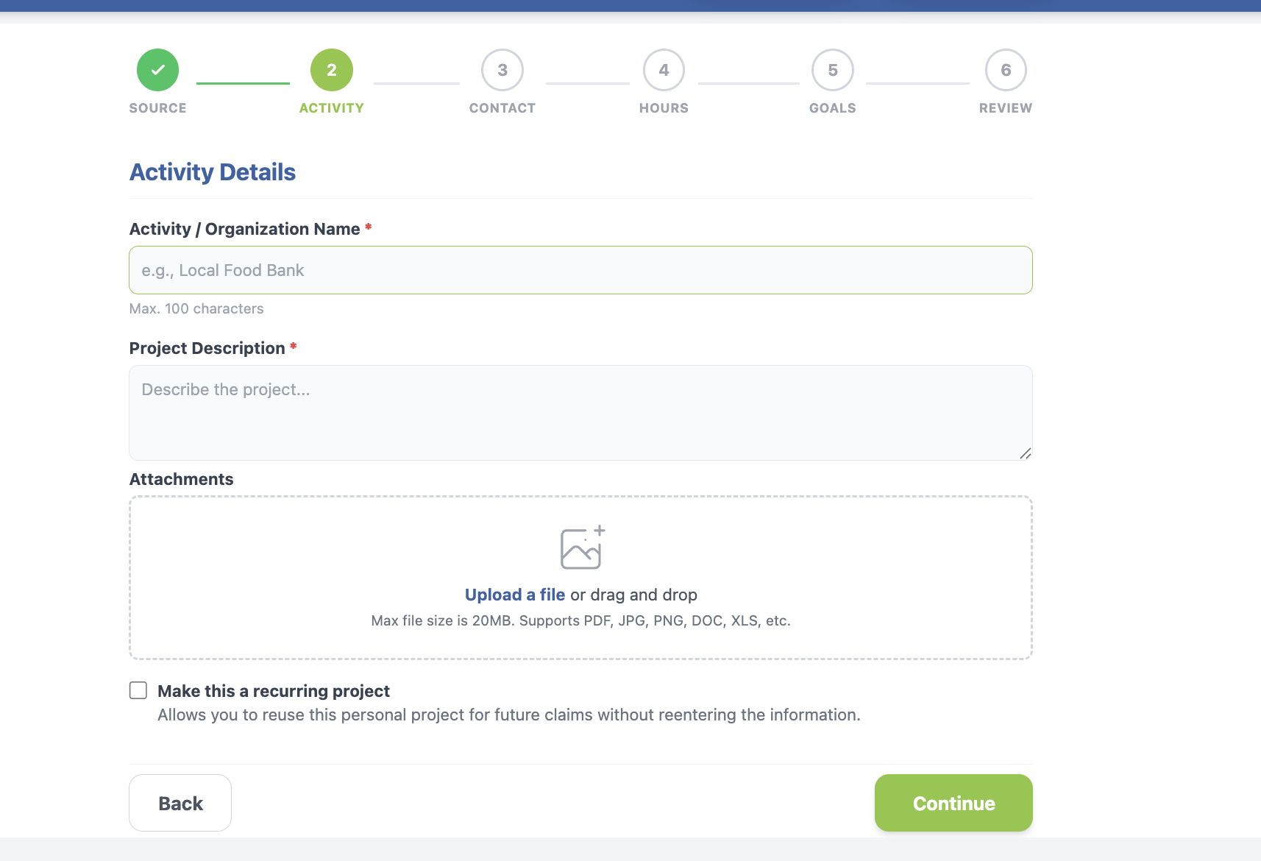
Log the details
Title your activity and add a description
Add attachments
Make it a recurring project to use later

Slide 9
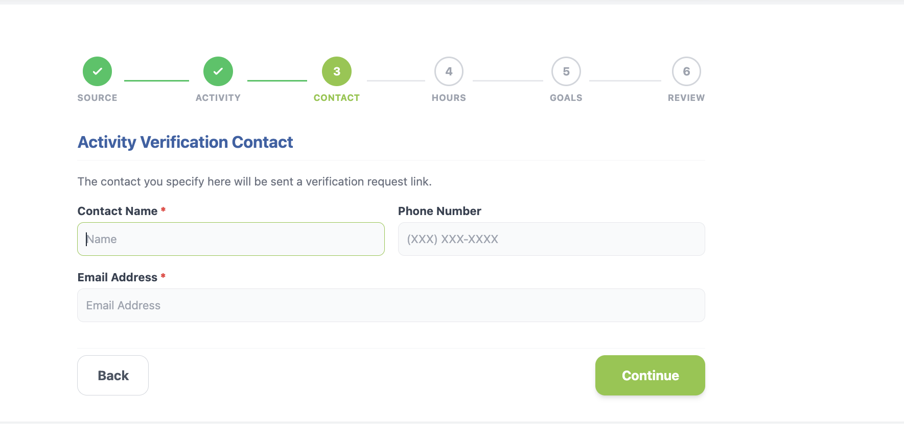
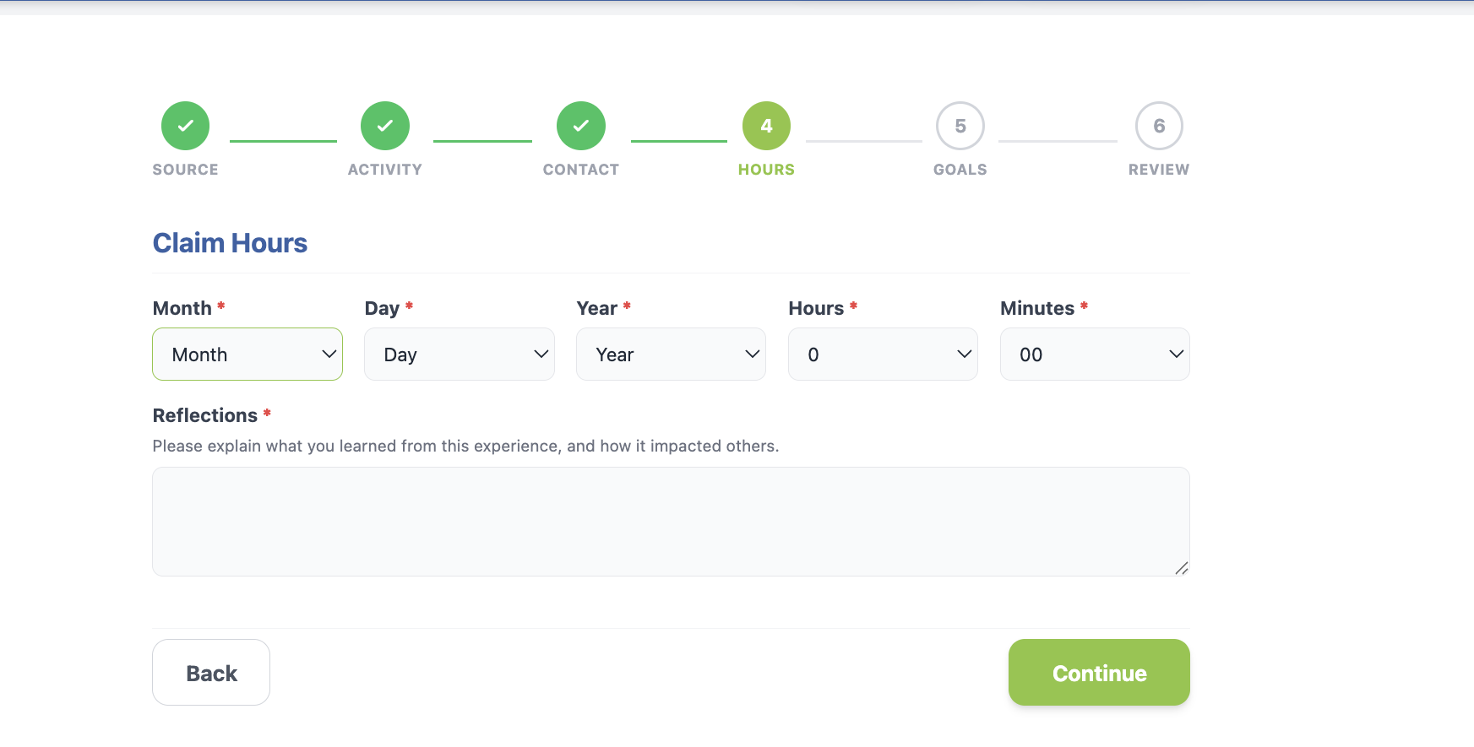
Log the details
Enter the Verification Contact Information accurately!
Enter the date and time you spent doing this activity
Add reflections

Slide 10
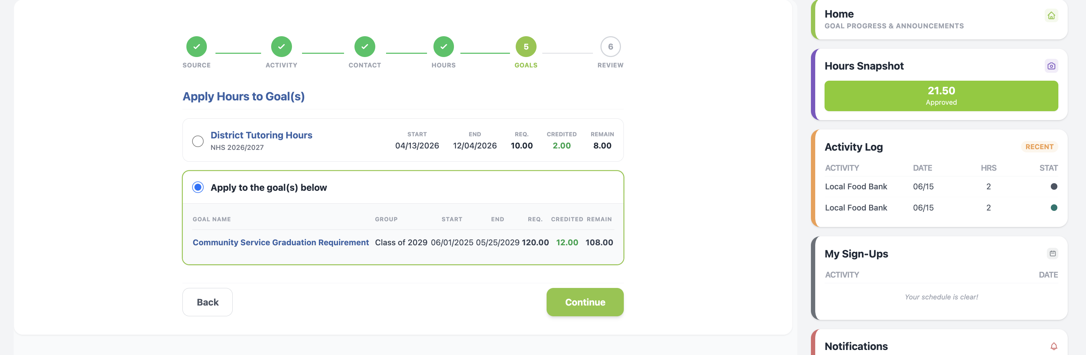
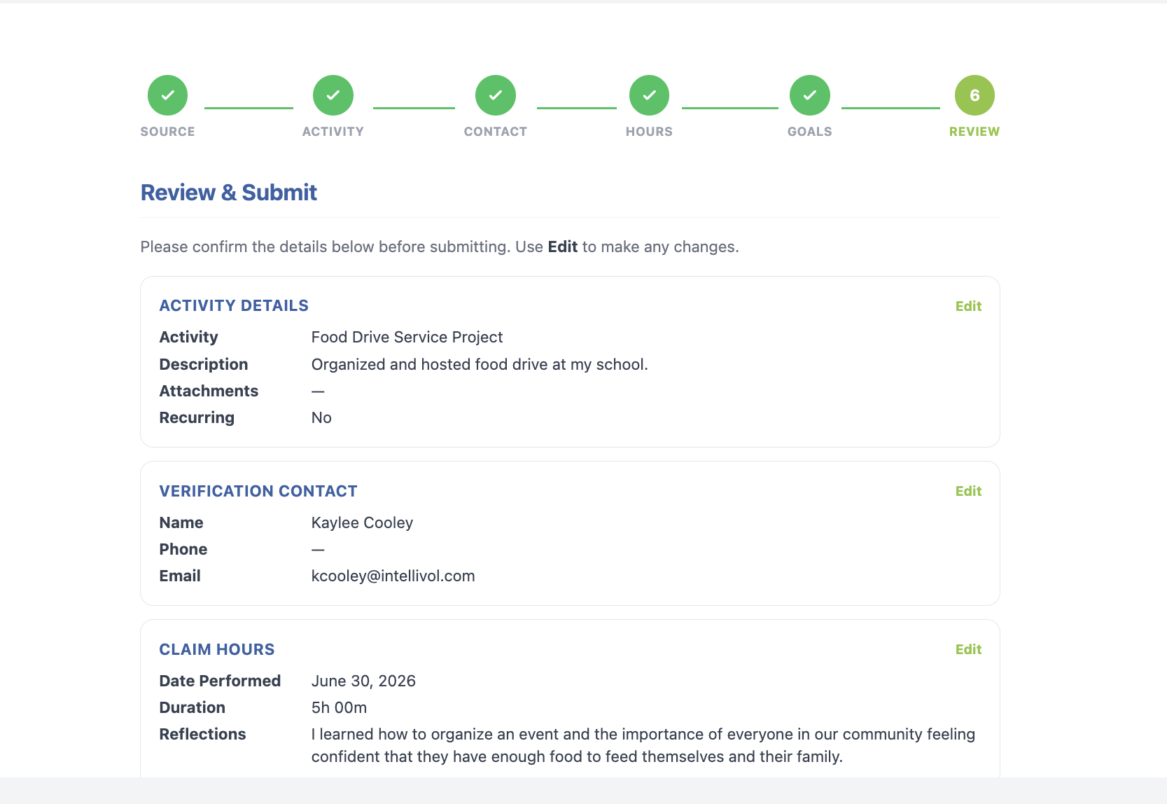
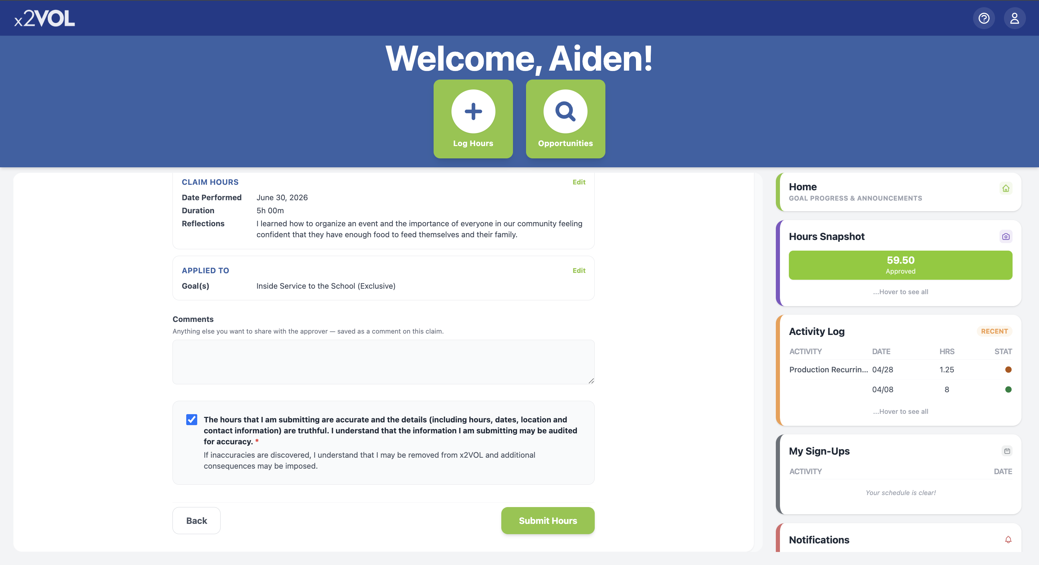
Log the details
Select the goal or category this activity belongs to
Review your submission and check the honor statement

Slide 11
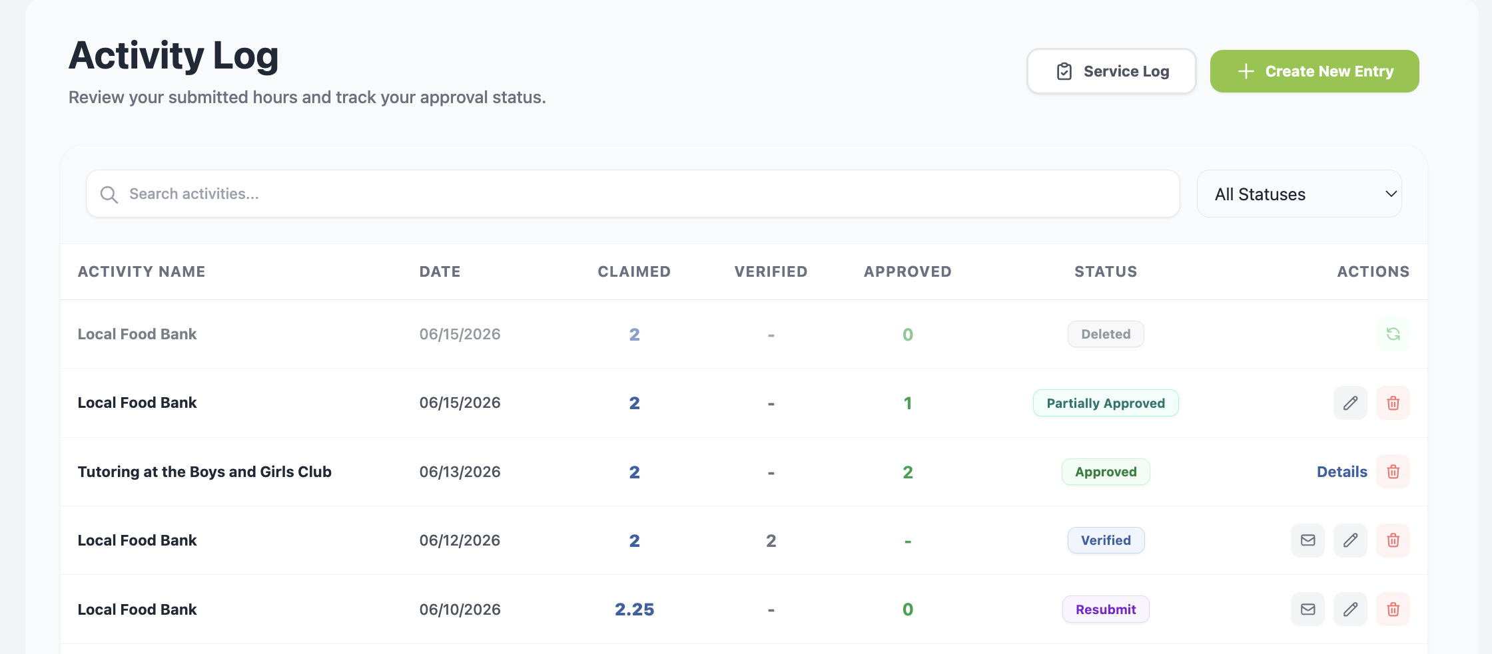
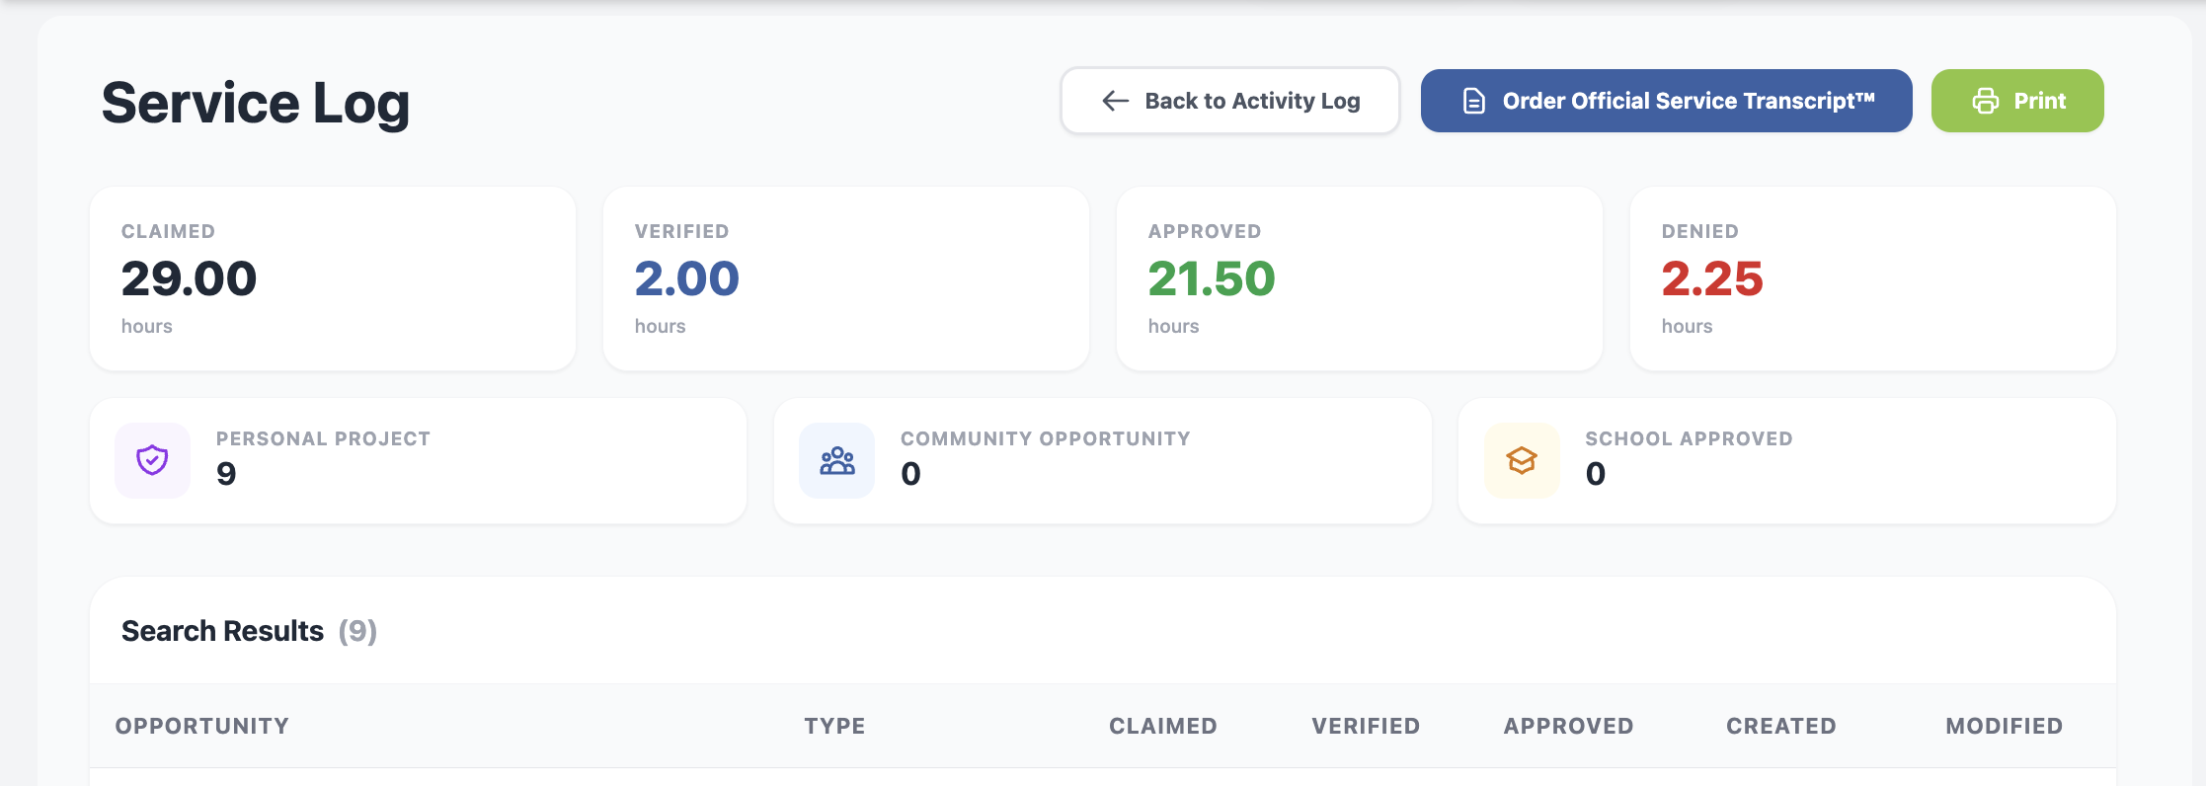
Print your Activity Log & Order an Official Service Transcript™
Click “Activity Log” in the right-side navigation panel
2.
Click “Service Log”
Click “Order Official Service Transcript™” or “Print”

Slide 12
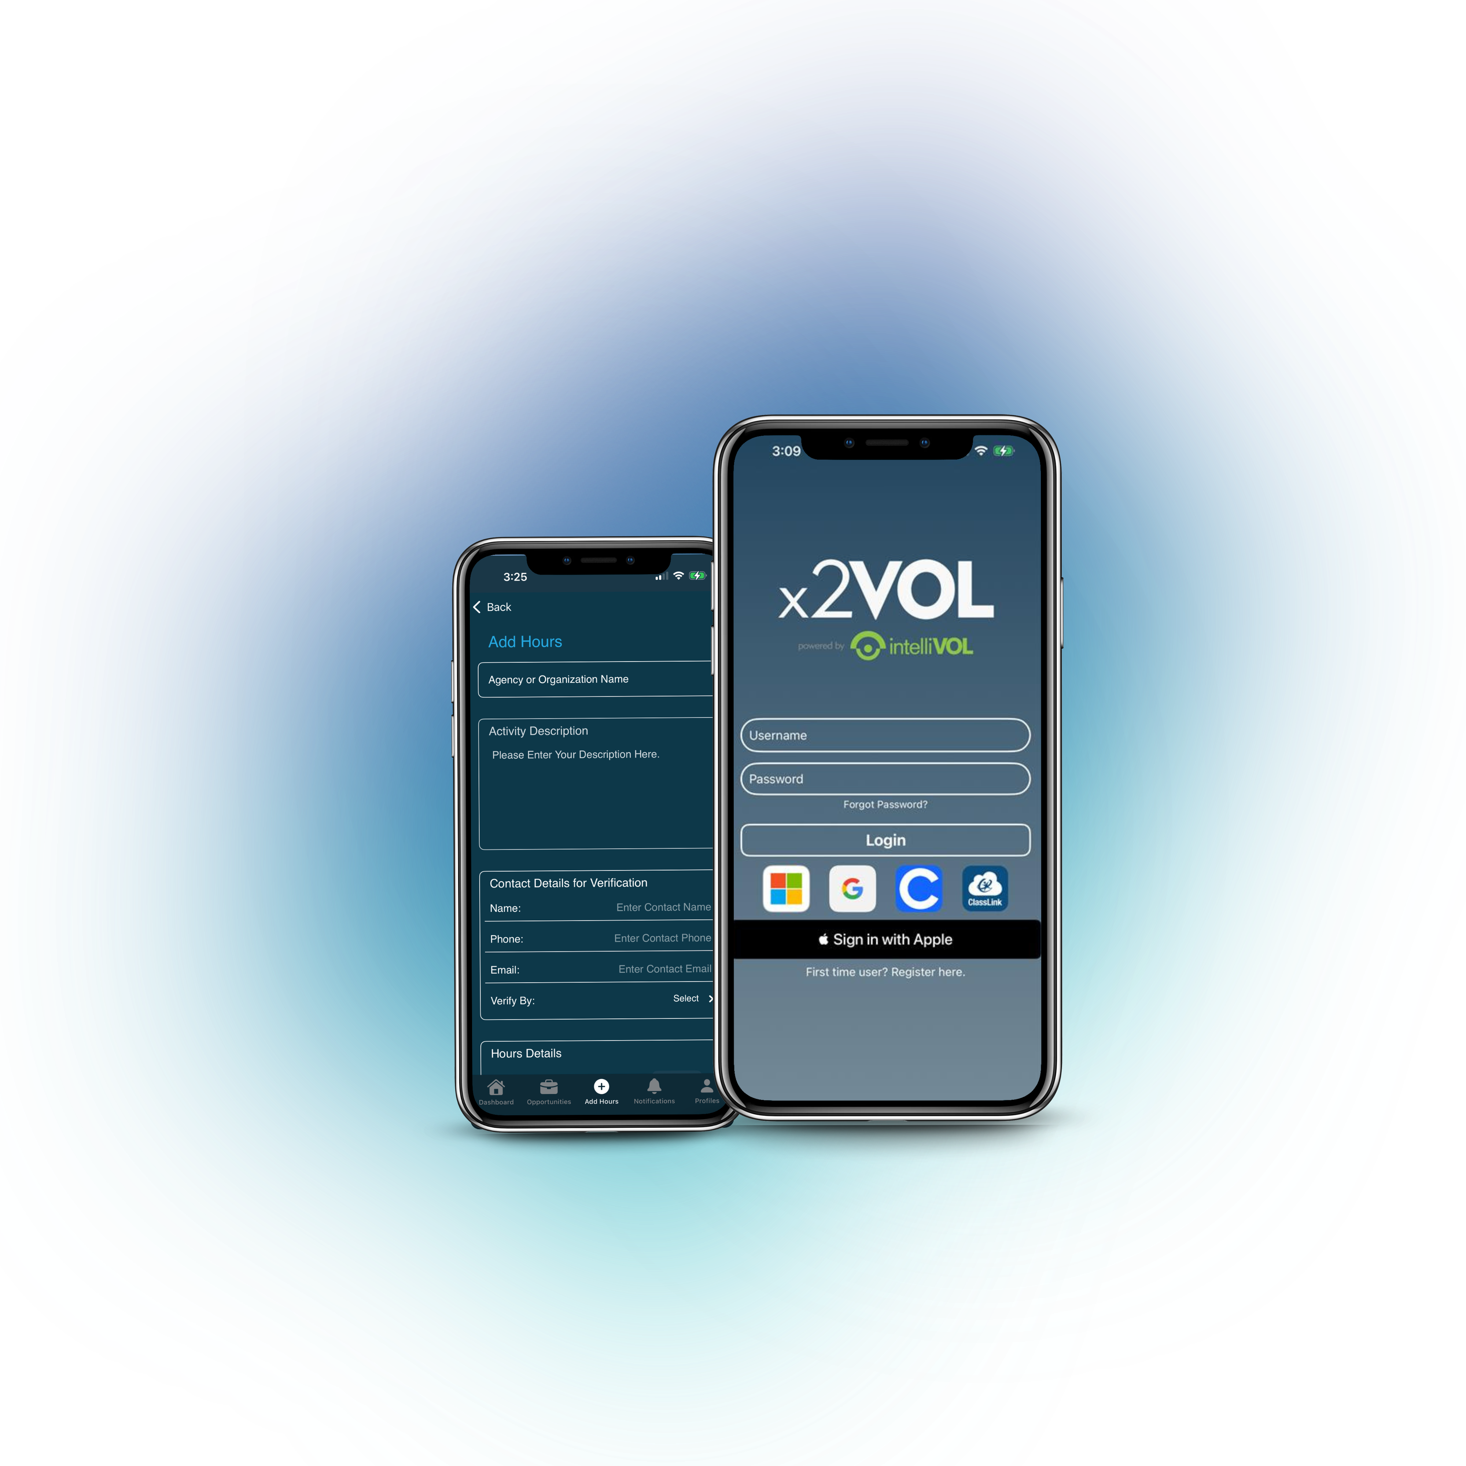


Download the x2VOL mobile app!
Try our iOS and Android mobile app to log your hours! Currently available for students, it can be found in the Apple App Store or Google Play Store.

Slide 13
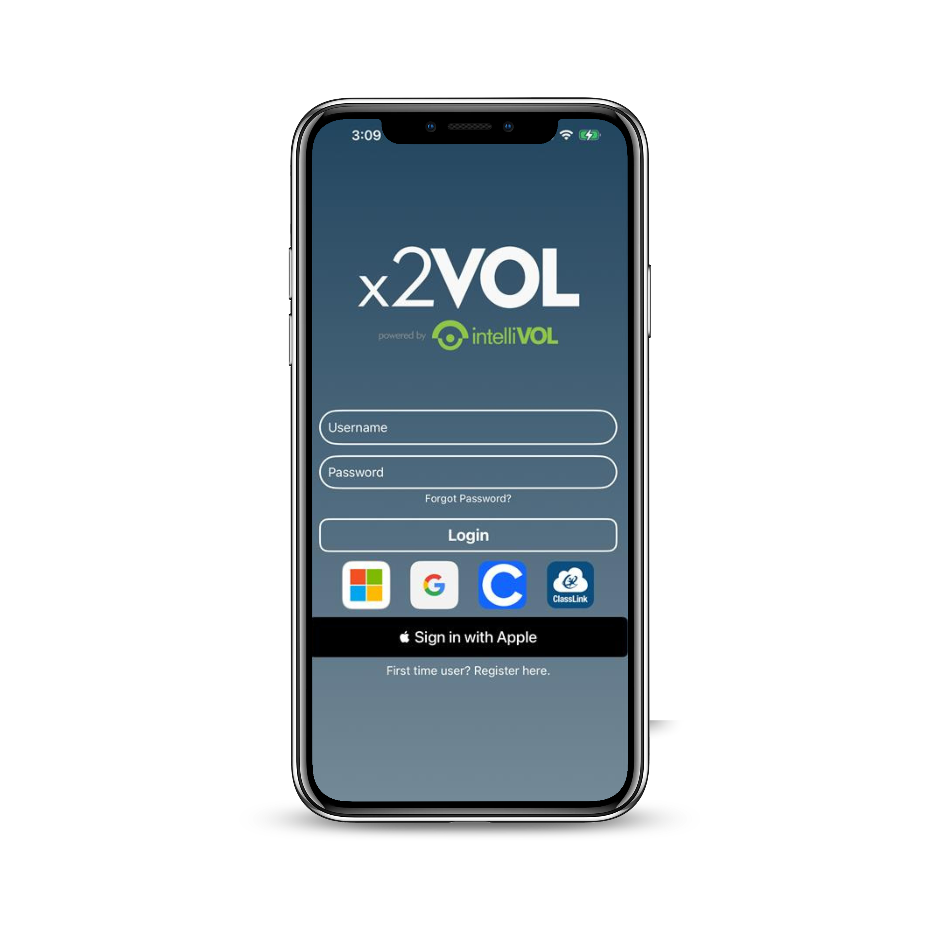
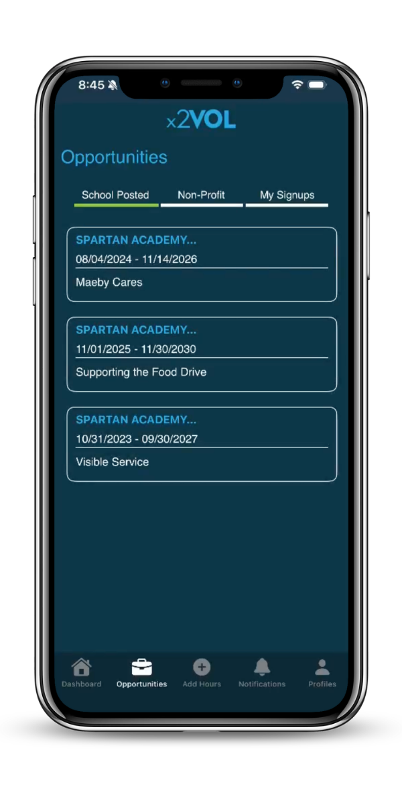
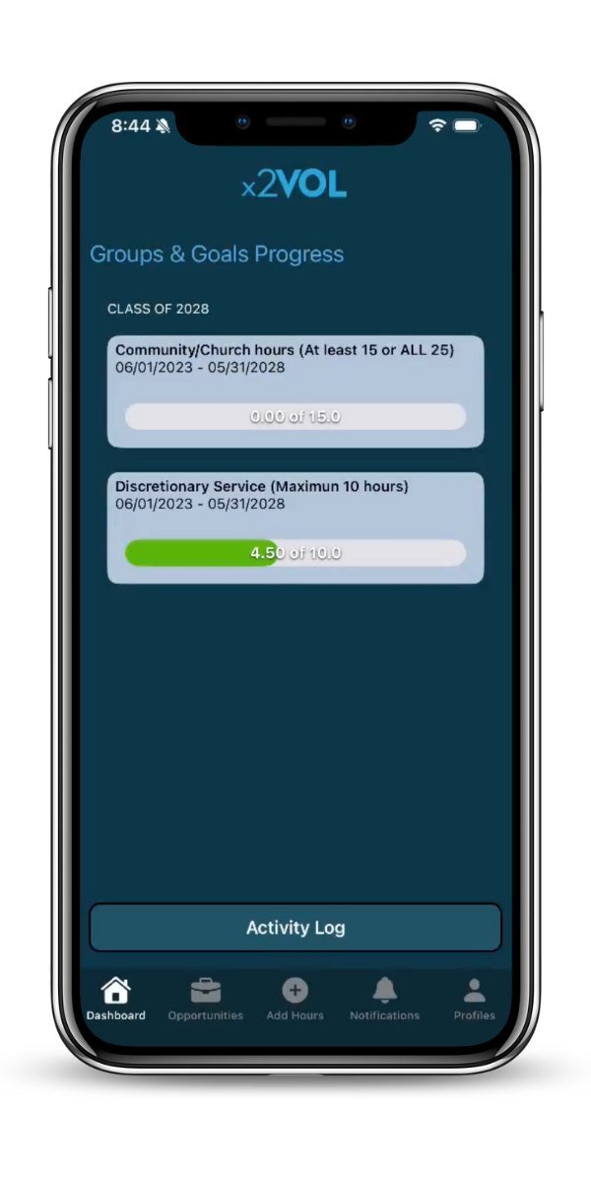
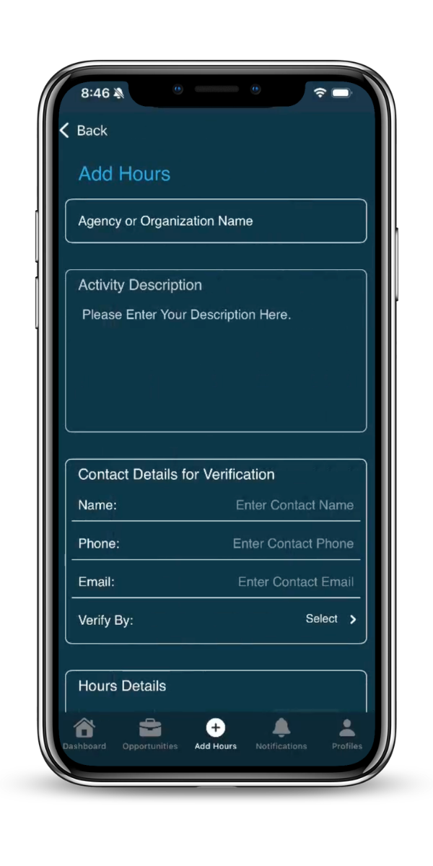
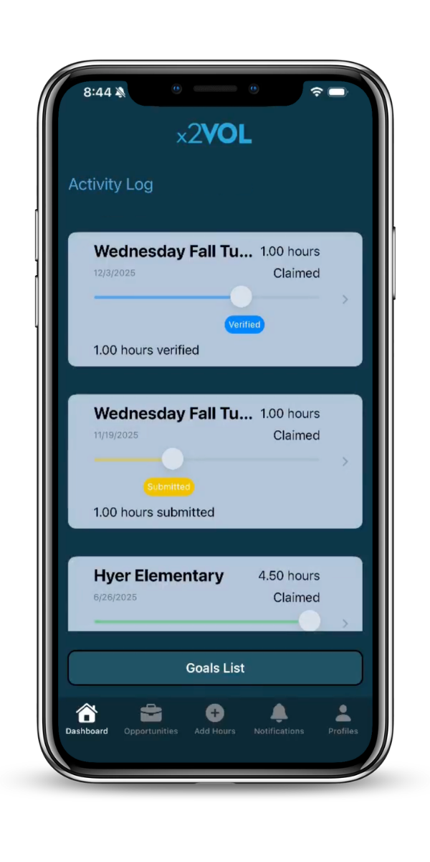







iOS Screens

Slide 14



Need Help?
Contact us:
Support@intellivol.com
866.906.6400
x2VOL.com

